Slide 1
The Science debate #6
by Satish

Slide 2
Debate #6
Will season calendar ever change?

Slide 3
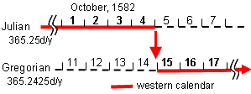
History of calendar

Slide 4
Seasons

Slide 5
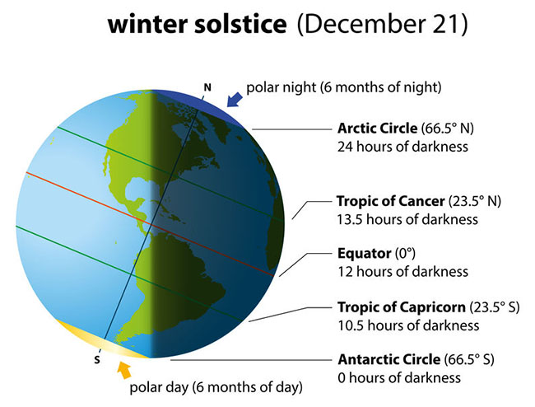
23.5˚
23.5˚

Slide 6
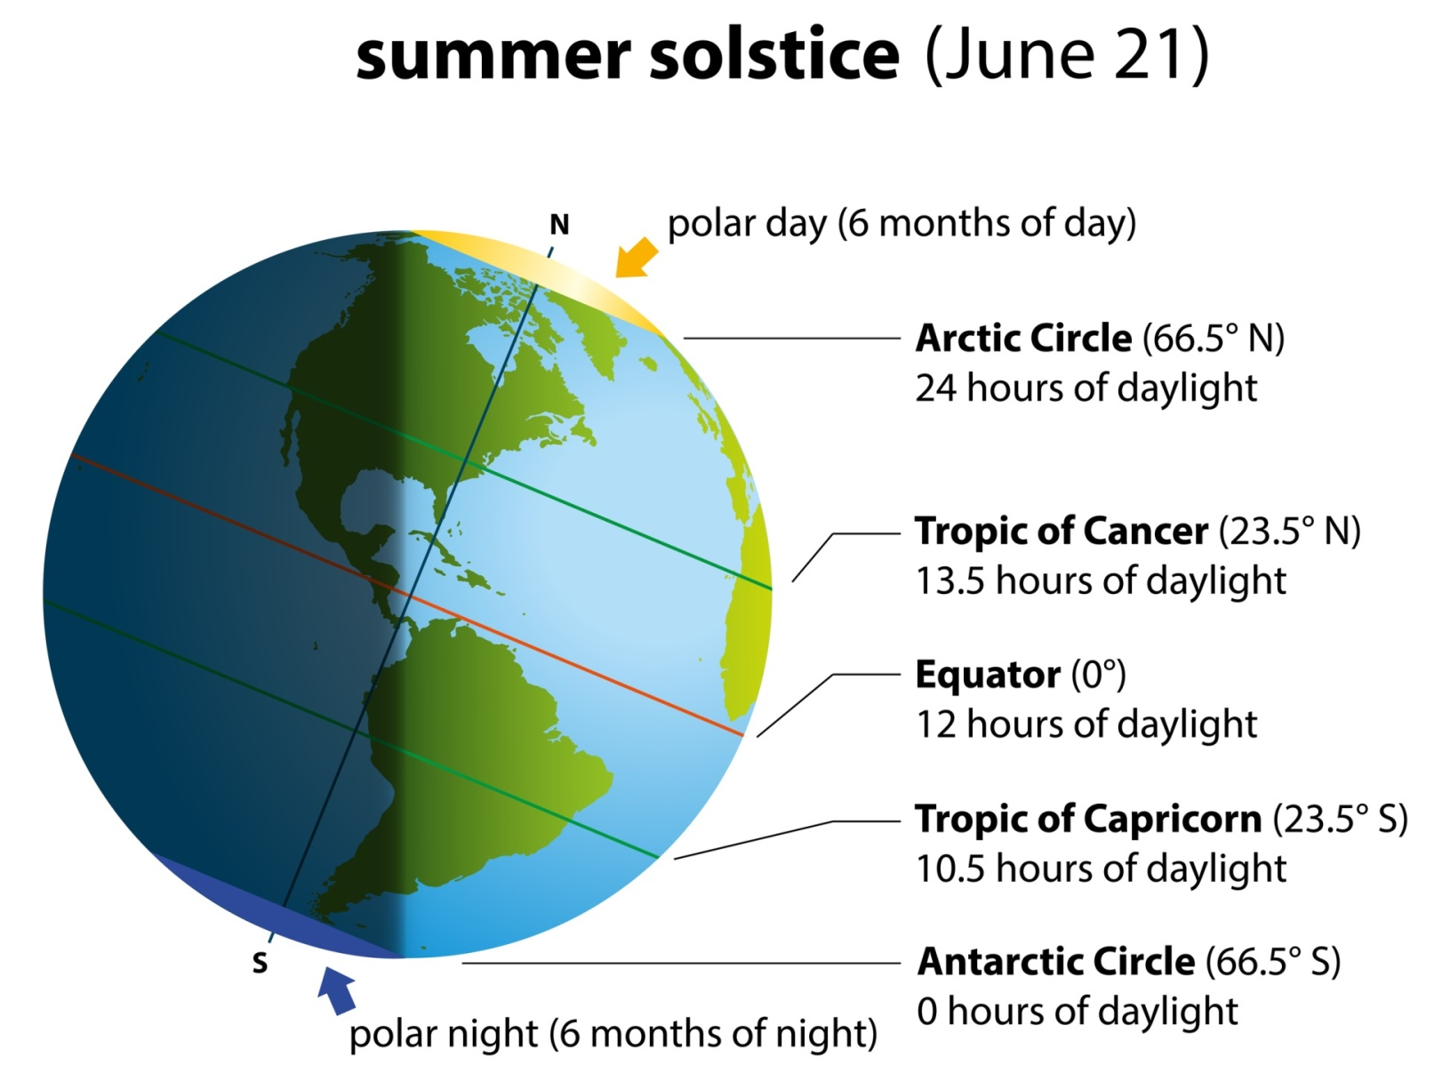
23.5˚
23.5˚

Slide 7
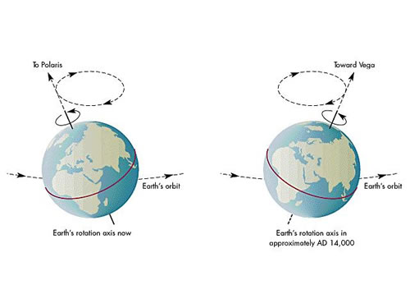
Precession
Earth rotation axis in 2020
After 12900 years
25800 years ~365 days of season shift = 365x24x60 min
1 year ~ 365x24x60/25800 = 20 min of season shift
(Sidereal year – Solar year)
Notes:
These dates will change due to precession aka conical movement of earth axis. One complete rotation of axis completes in 25800 years. This means in every 12900 years, the equinox and solistice would shift by 6 months. Shift of equinox/solistice 20 min per year which is the difference between sidereal year and tropical year (365d*24h*60m/25800y = 20 min per year)
Sidereal year takes star as reference and is 20 min longer than solar or tropical year

Slide 8
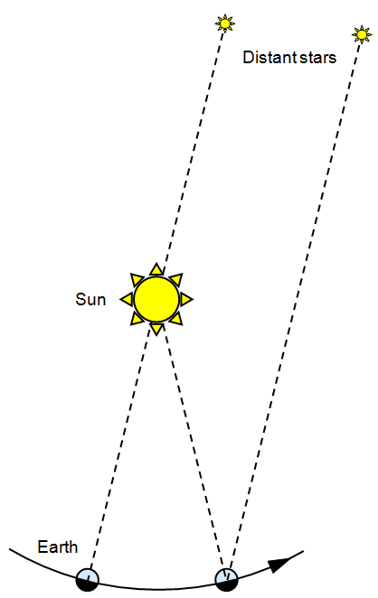

Slide 9
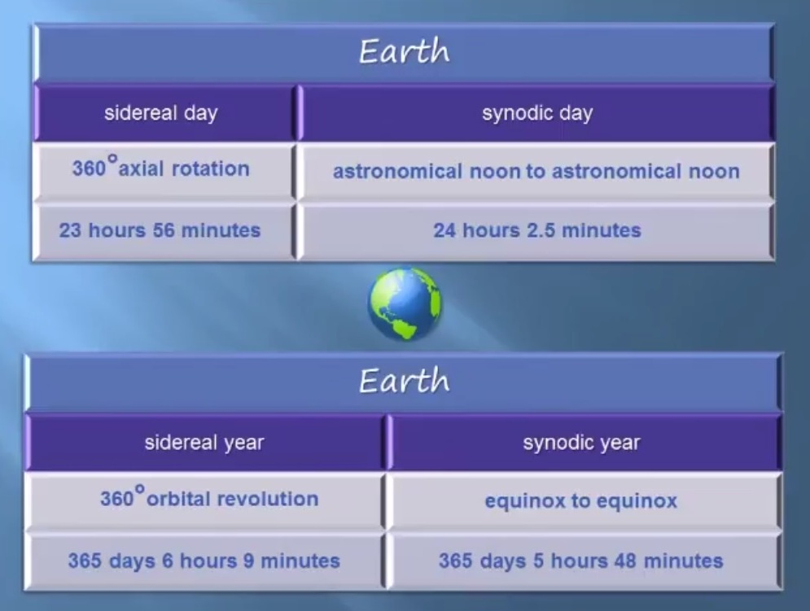
Sidereal time

Slide 10
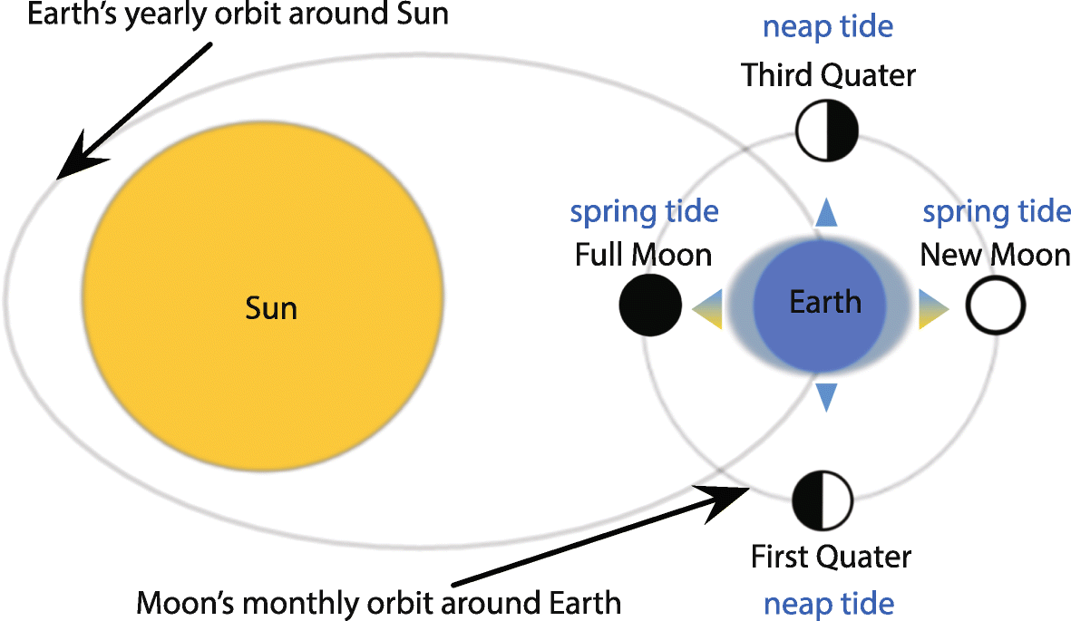
Tides

Slide 11
Moon wobble

Slide 12
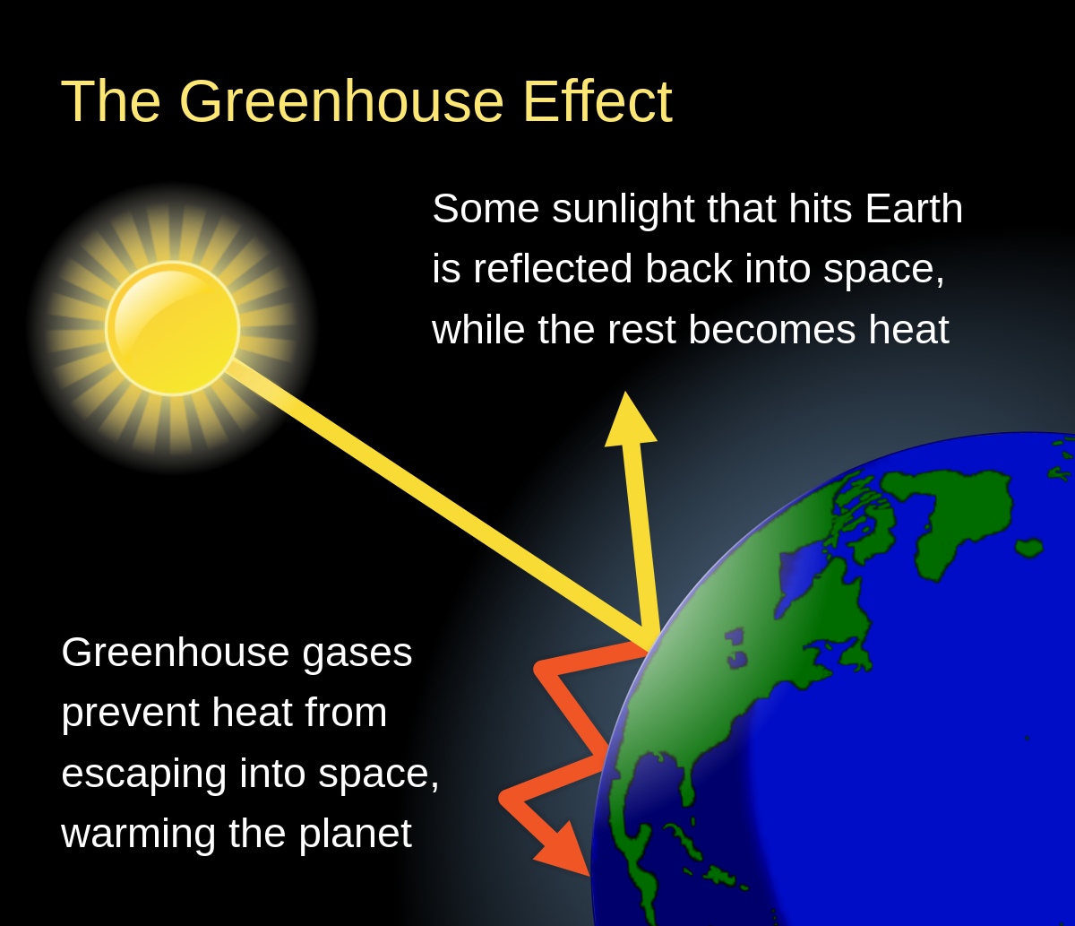
Global warming

