Slide 1
Science – Yesterday, Today & Tomorrow session 9
By Satish Kumar

Slide 2
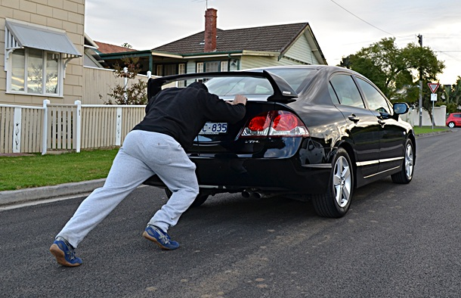
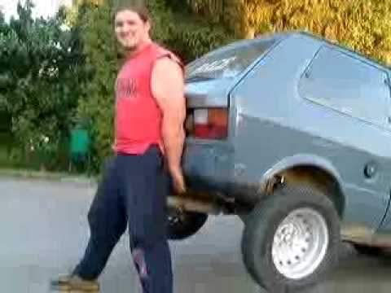
Which needs more power?
B
A

Slide 3
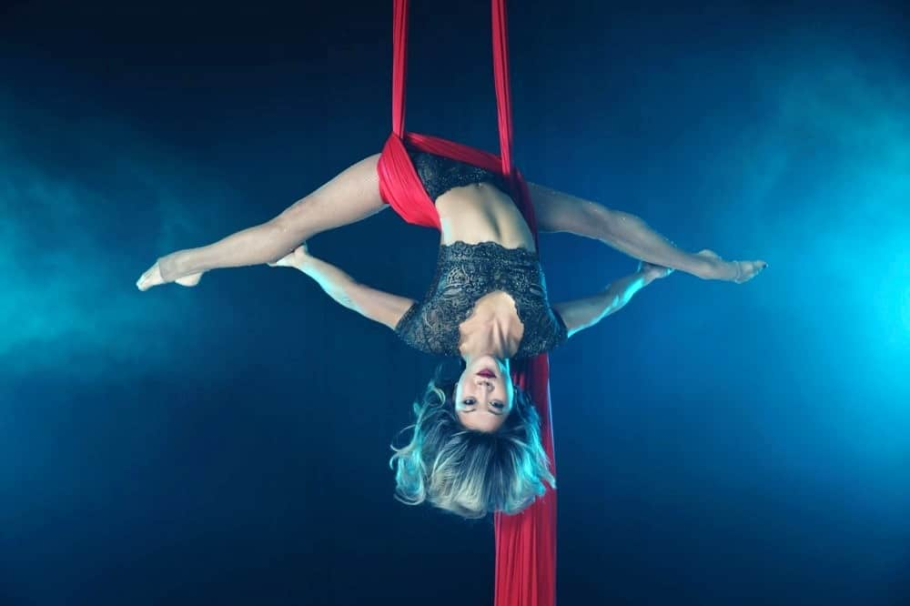
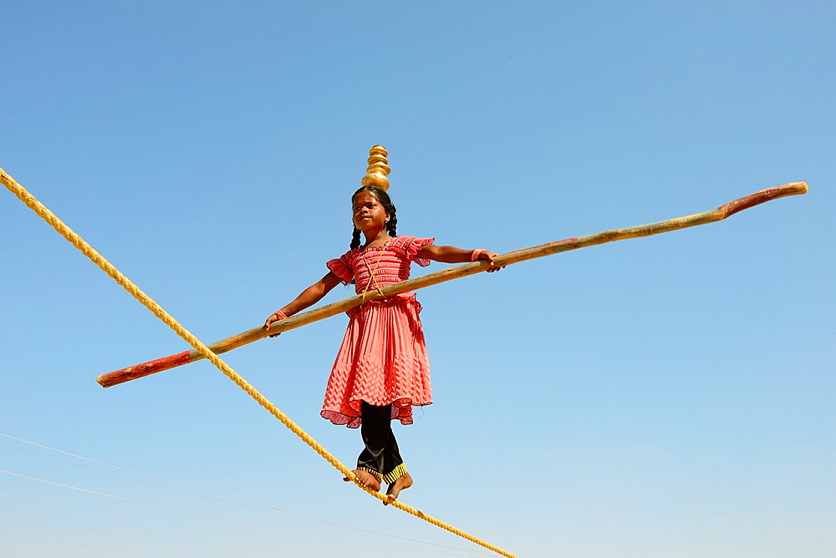
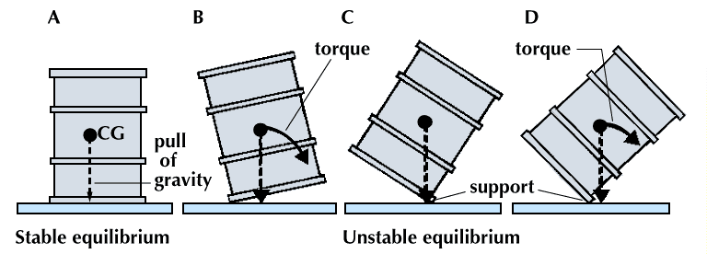
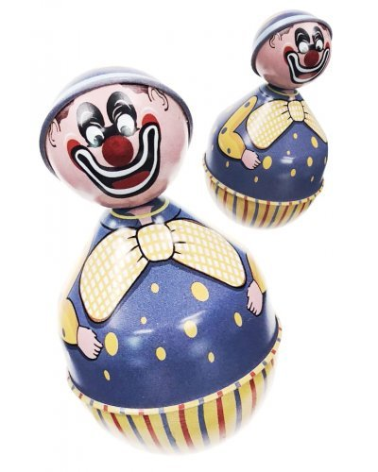

Slide 4
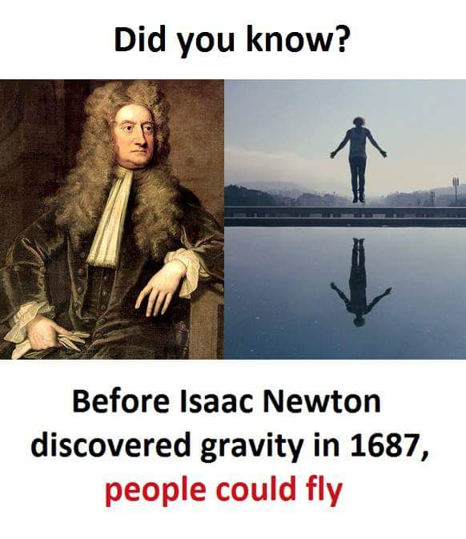

Slide 5
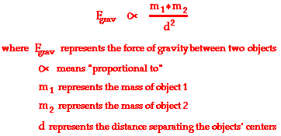
Newton’s law of Gravitation
Gravity, an attractive force, effective equally to both objects
Gravity, a Universal force, applicable to all objects
Measured from centre (of gravity) of an object
Force proportional to masses of attracting bodies (m)
Force inversely proportional to square of distance (d)
https://www.youtube.com/watch?v=_KJHRF6RlTQ
Notes:
Exercise – Moving and lifting (Inertia & Weight)
Mass concentrated at center of spherical bodies

Slide 6
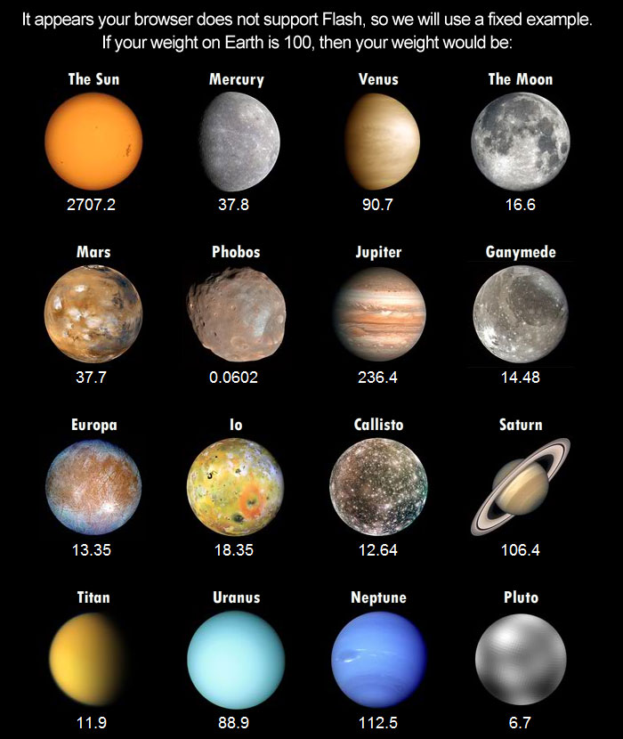
Weights in different planets

Slide 7
