Slide 1
Science – Yesterday, Today & Tomorrow session 8
By Satish Kumar

Slide 2
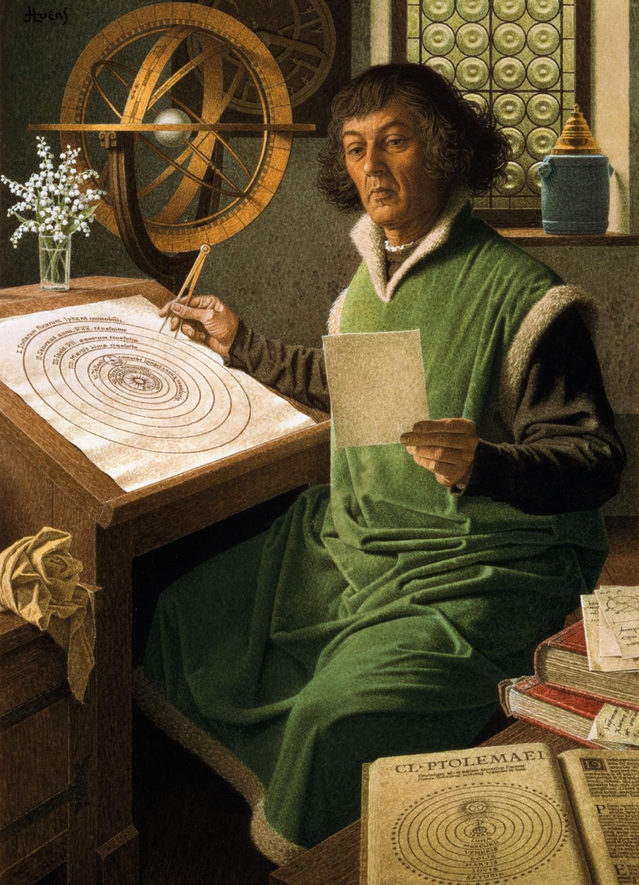
Heliocentric model – Copernicus (1473 – 1543 CE)
Notes:
20th-century painting by Jean-Léon Huens

Slide 3
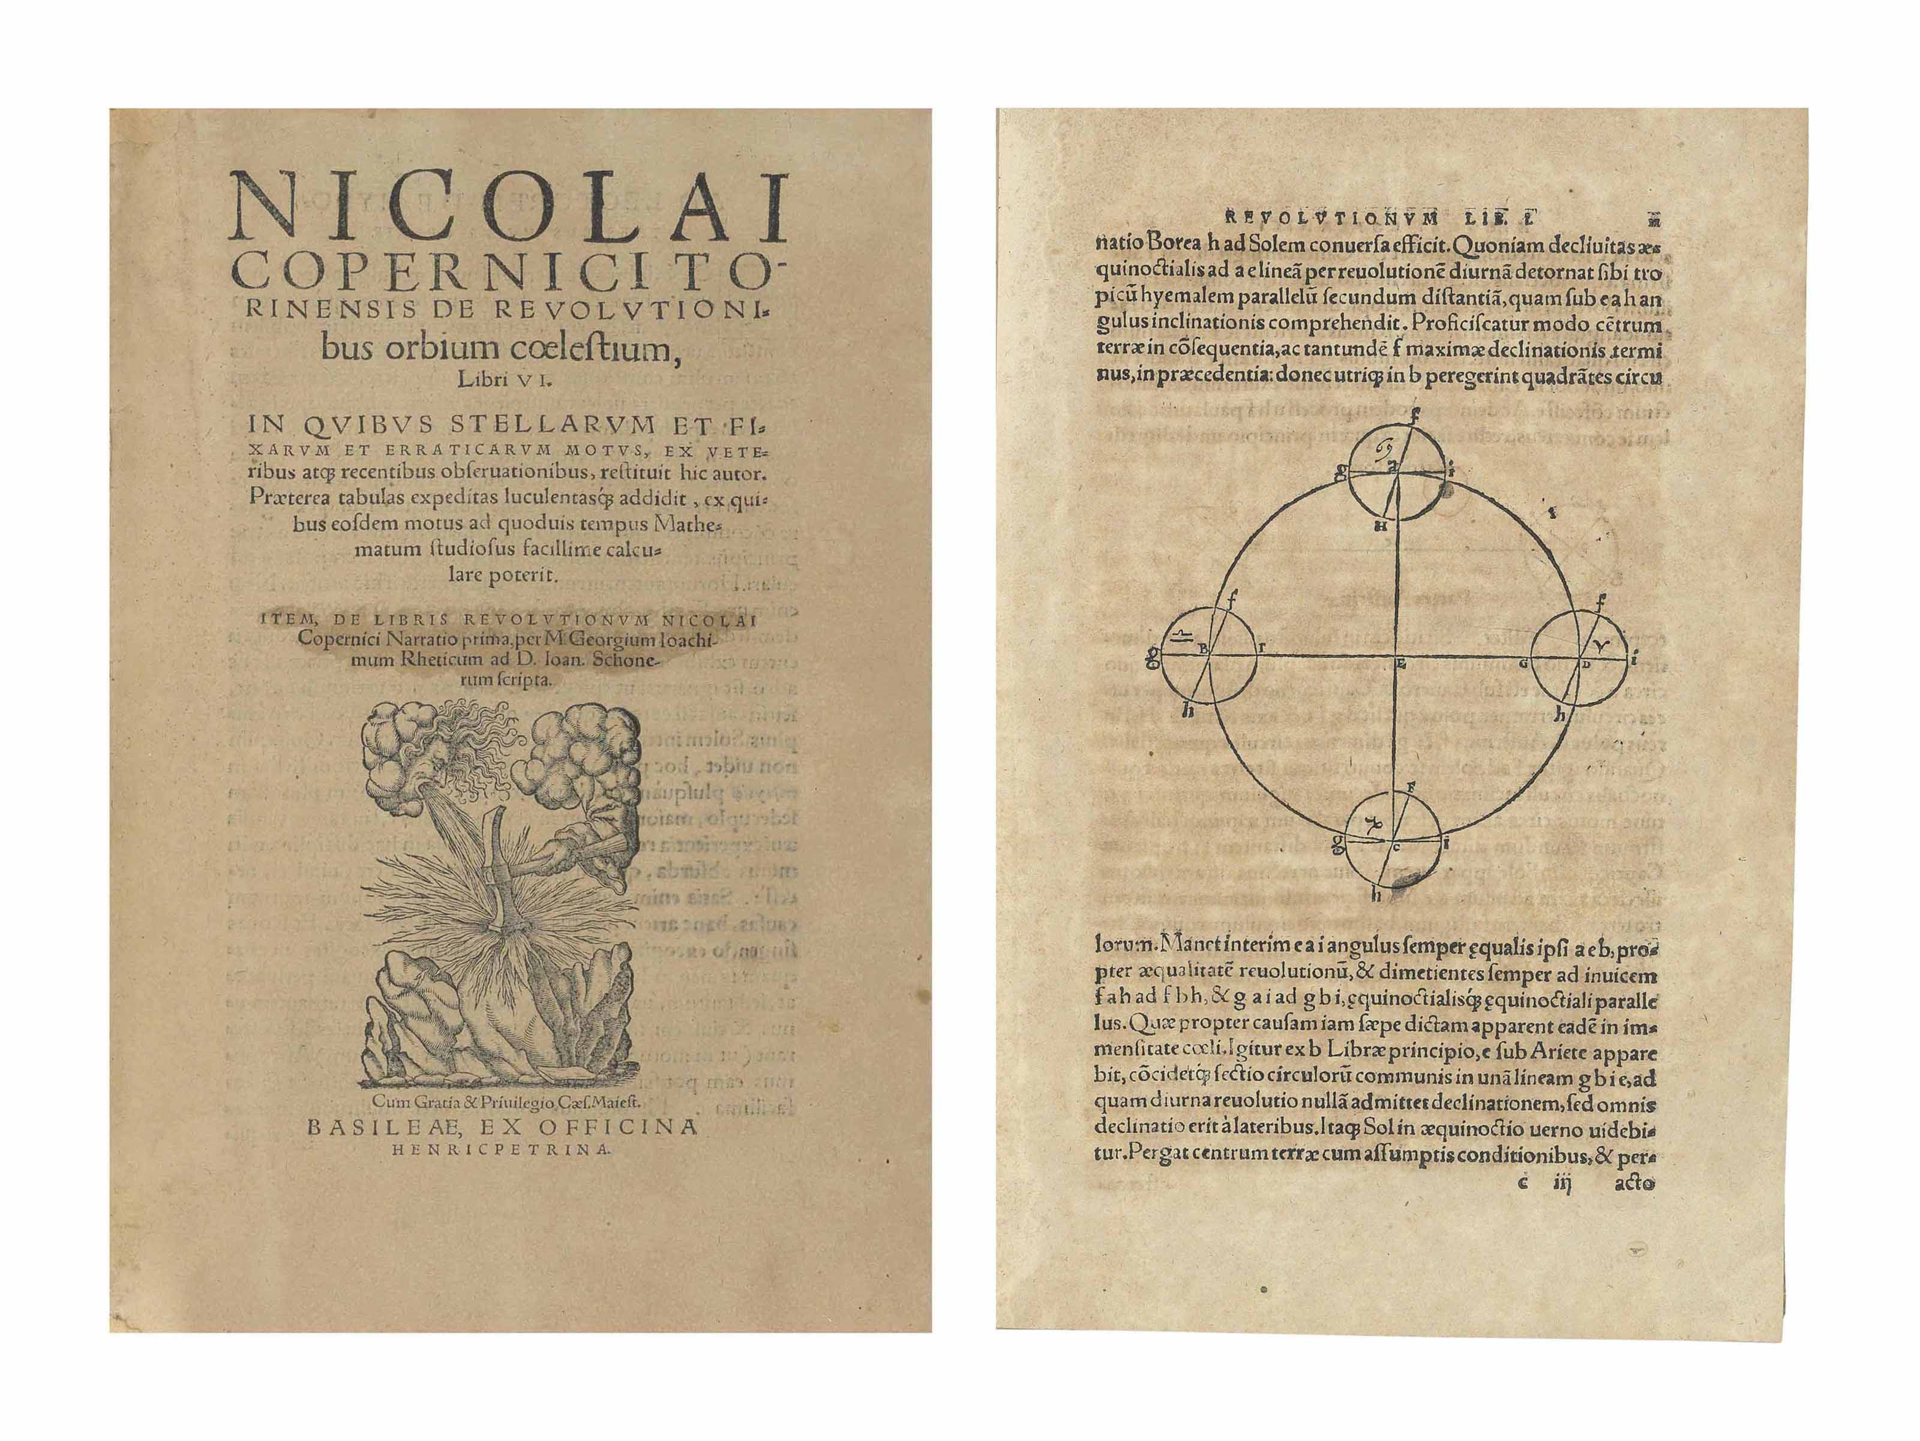
On the revolutions of heavenly spheres

Slide 4
Copernicus model

Slide 5
Geo to Helio centric Universe
Copernicus model (1473 – 1543 CE)
Parallax
Stable Sun, Moving Earth
Sizes of Mercury & Venus
Galileo (1564 – 1642 CE)
4 moons of Jupiter
Venus observations
Notes:
In Geo centric model, only one phase of Venus can be observed. Galileo proved with his advanced Telescope that all phases of Venus can be viewed. Invention of Telescope is credited to Hans Lippershey.

Slide 6
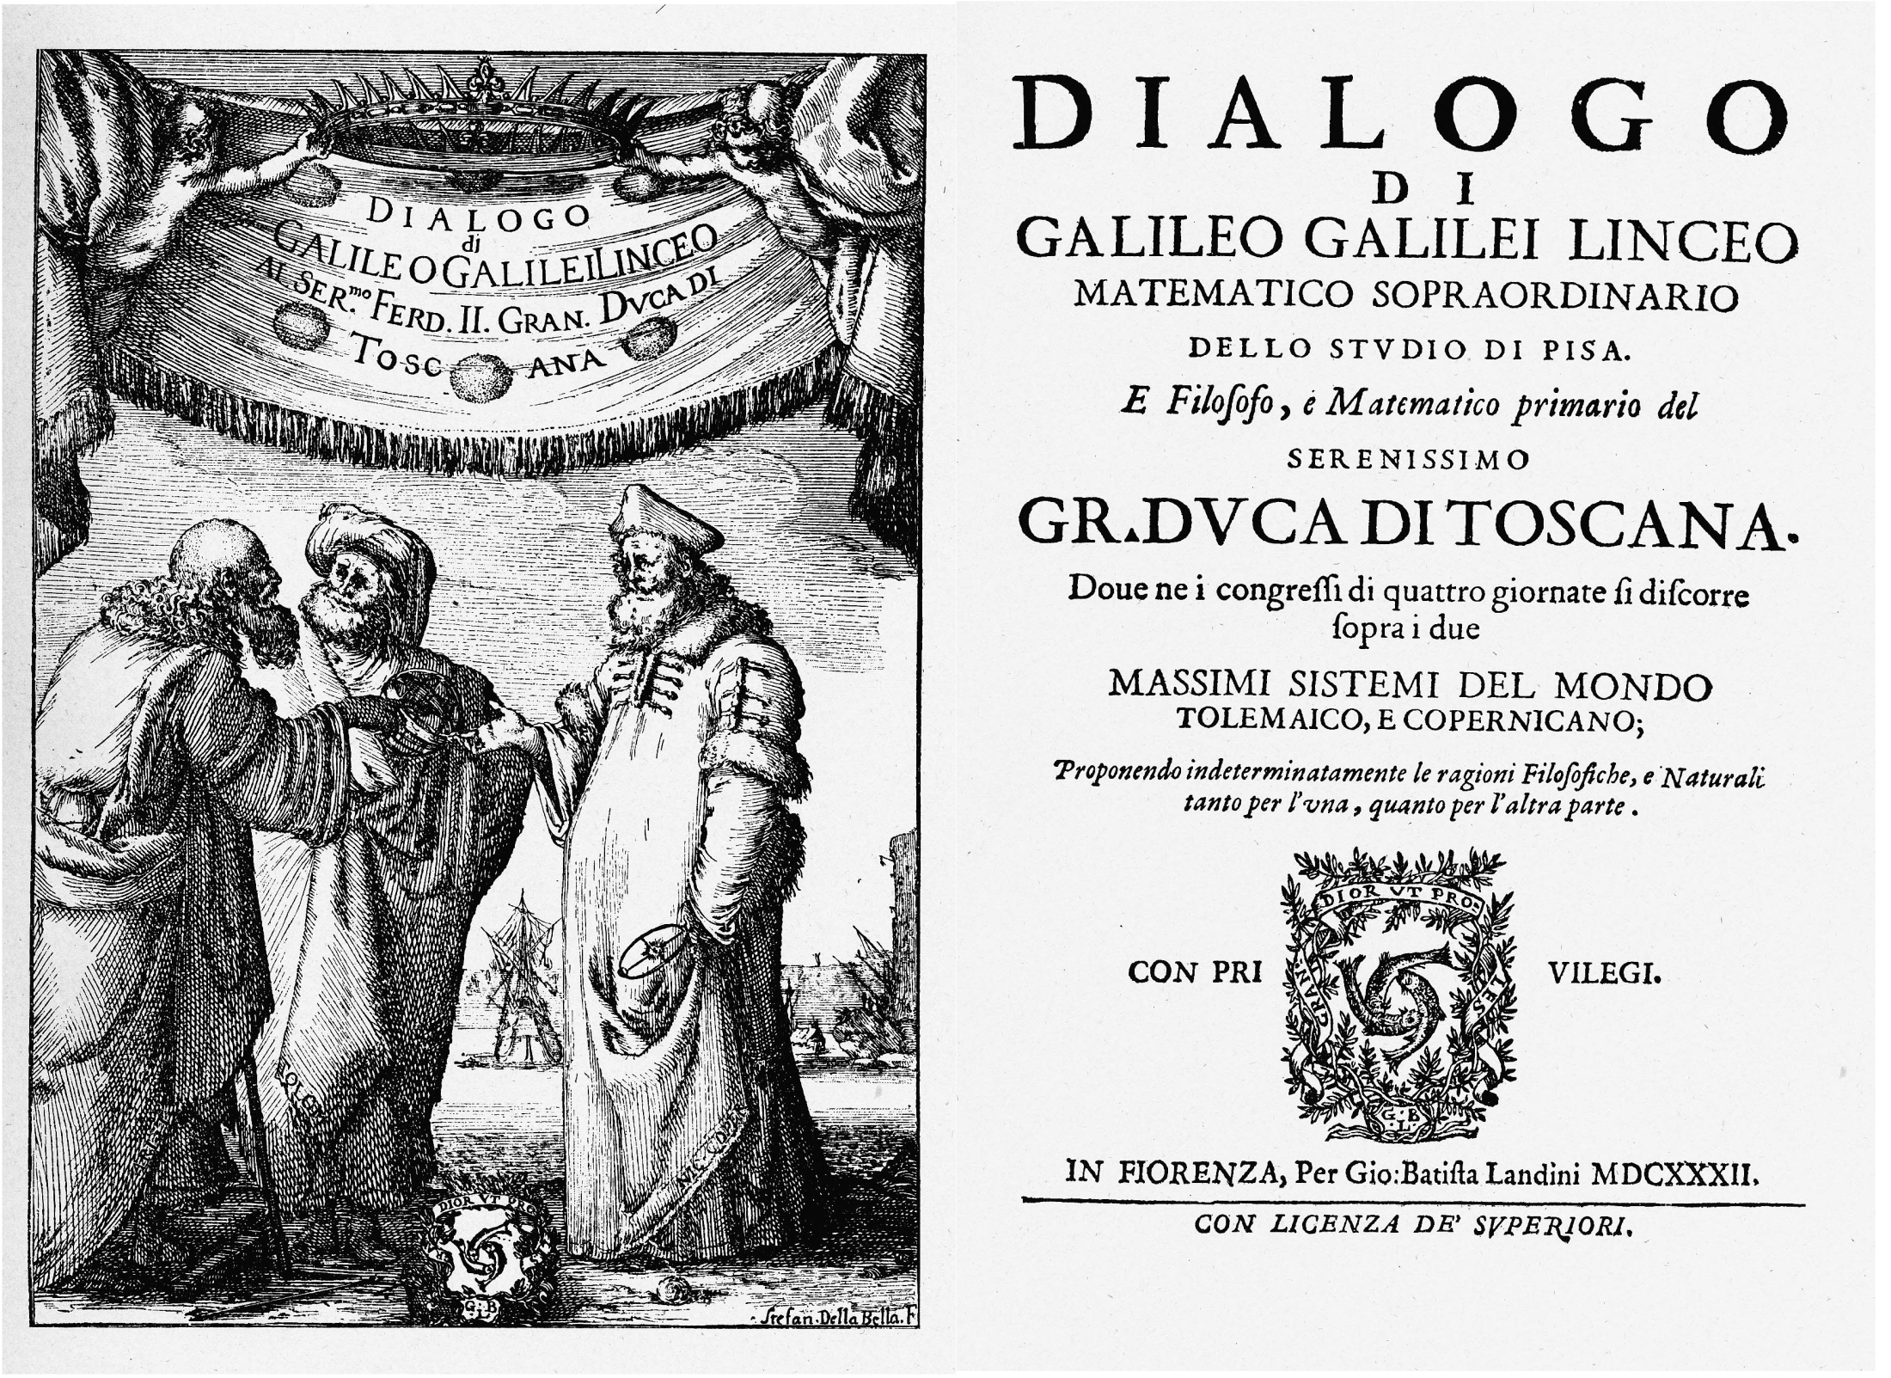

Slide 7
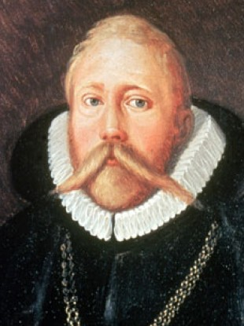
Tycho Brahe (1546 – 1601)
https://youtu.be/7QDvKzY4aqA

Slide 8
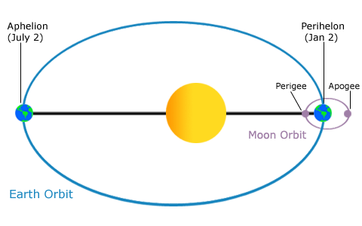
Kepler laws (1571 – 1630 CE)
Law of ellipses
Eccentricity of Earth’s orbit = 0.0167
Notes:
The path of the planets about the sun is elliptical in shape, with the center of the sun being located at one focus. (The Law of Ellipses)
An imaginary line drawn from the center of the sun to the center of the planet will sweep out equal areas in equal intervals of time. (The Law of Equal Areas)
The ratio of the squares of the periods of any two planets is equal to the ratio of the cubes of their average distances from the sun. (The Law of Harmonies)

Slide 9
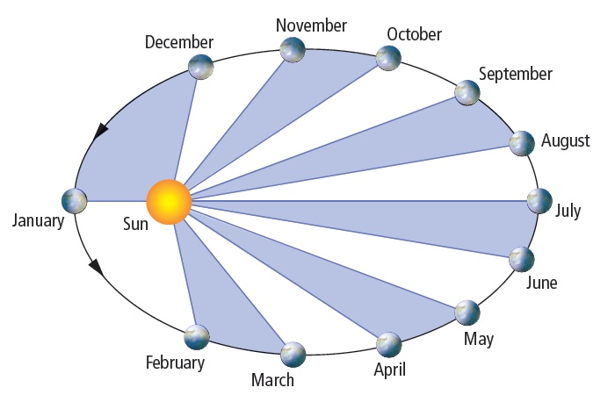
Kepler laws
Law of equal areas
If an imaginary line were drawn from the center of the planet to the center of the sun, that line would sweep out the same area in equal periods of time.
Notes:
The path of the planets about the sun is elliptical in shape, with the center of the sun being located at one focus. (The Law of Ellipses)
An imaginary line drawn from the center of the sun to the center of the planet will sweep out equal areas in equal intervals of time. (The Law of Equal Areas)
The ratio of the squares of the periods of any two planets is equal to the ratio of the cubes of their average distances from the sun. (The Law of Harmonies)

Slide 10
Kepler laws
Law of harmonies - The ratio of the squares of the periods to the cubes of their average distances from the sun is the same for every one of the planets (T²/R³ is constant)
Planet | Period (yr) | Average Distance (au) | T²/R³ (yr²/au³)
Mercury | 0.241 | 0.39 | 0.98
Venus | .615 | 0.72 | 1.01
Earth | 1.00 | 1.00 | 1.00
Mars | 1.88 | 1.52 | 1.01
Jupiter | 11.8 | 5.20 | 0.99
Saturn | 29.5 | 9.54 | 1.00
Uranus | 84.0 | 19.18 | 1.00
Neptune | 165 | 30.06 | 1.00
Pluto | 248 | 39.44 | 1.00
(T)
(R)
Notes:
The path of the planets about the sun is elliptical in shape, with the center of the sun being located at one focus. (The Law of Ellipses)
An imaginary line drawn from the center of the sun to the center of the planet will sweep out equal areas in equal intervals of time. (The Law of Equal Areas)
The ratio of the squares of the periods of any two planets is equal to the ratio of the cubes of their average distances from the sun. (The Law of Harmonies)

Slide 11
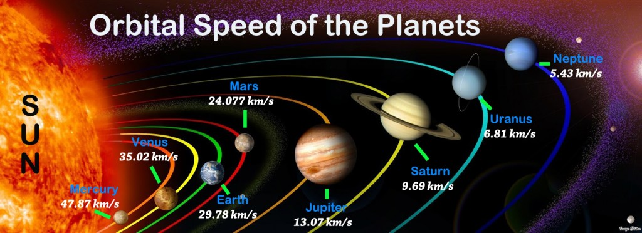
Orbital speed of solar planets

Slide 12
