Slide 1
Science – Yesterday, Today & Tomorrow session 7
By Satish Kumar

Slide 2
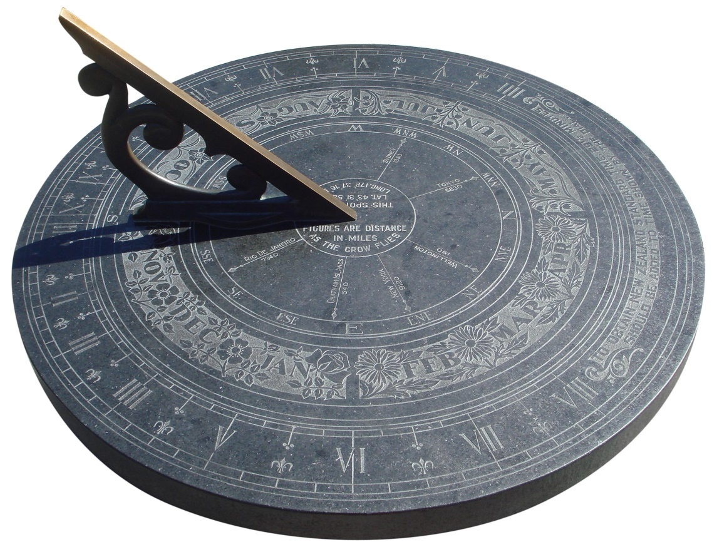
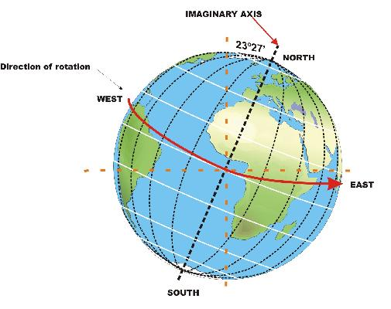

Slide 3
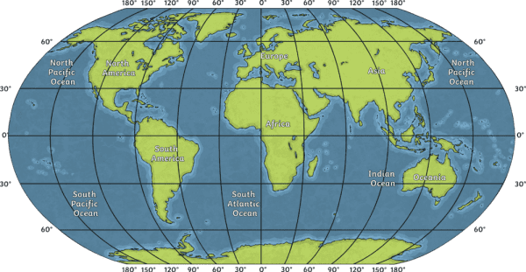
1 deg = 4 min
15 deg = 60 min

Slide 4
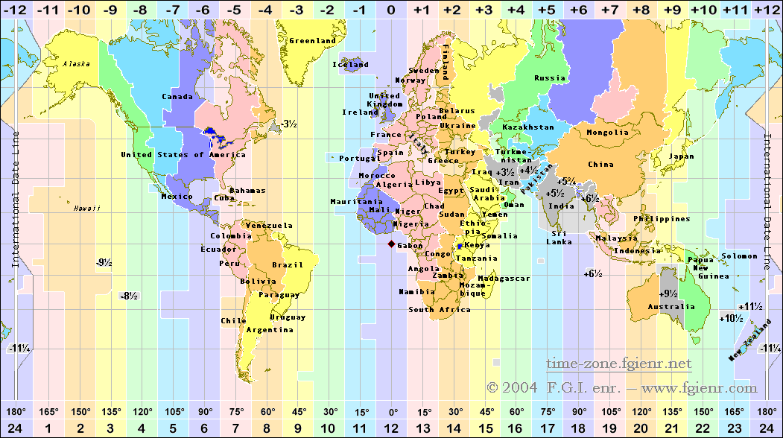

Slide 5
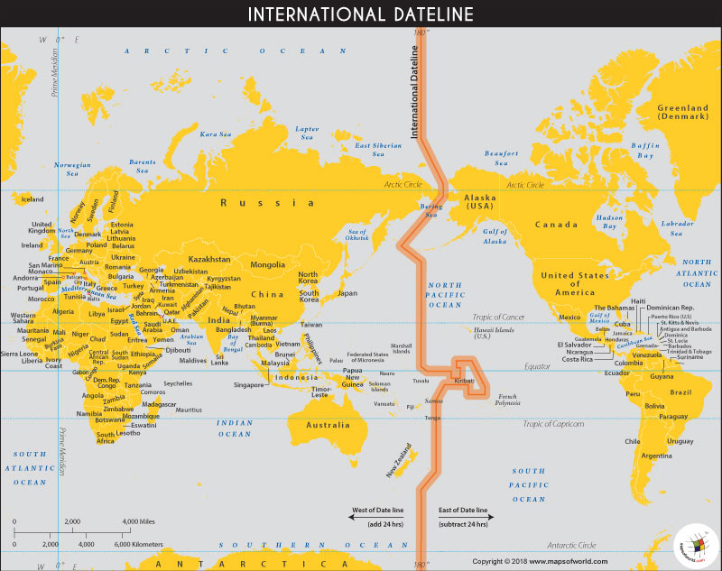

Slide 6
Arabian Science – Golden age
Abbasid caliphate (800 – 1250 CE)
Harun al-Rashid & al-Mamun
Govt. sponsored research
Translation from Indian, Greek, Persian books
Bayt-al-Hikma (House of Wisdom - 830)
Al-Azhar University (970) in Cairo
Al-Nizamiyya (1095) in Baghdad

Slide 7
Geo to Helio centric Universe
Contributions from Arab Scientists (800 – 1250)
Al Khwarizmi – Father of Algebra
Al Hazen – Father of Optics
Jabir Ibn Hayyan – Father of Alchemy
Jamshid Al Kashi – Planetary computer
Ibn Sina – Canon of Medicine
Al Biruni – Earth’s diameter
Nasir Al Din Al Tusi – Questioned Ptolemy’s model
Al Battani – Astronomical tables used by Copernicus

Slide 8
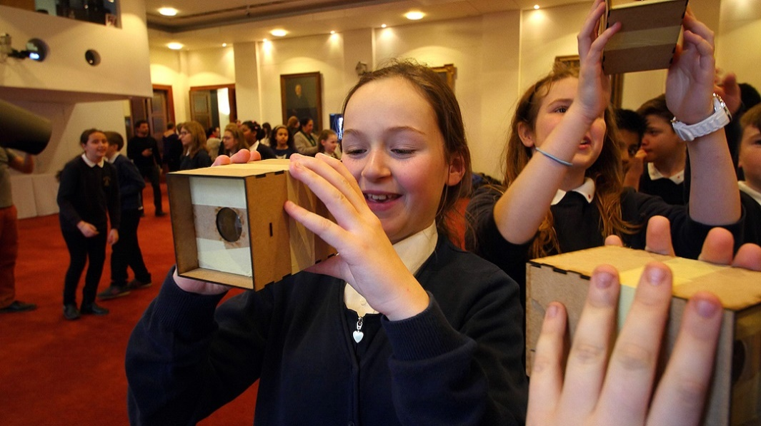
International year of light
Notes:
Camera Obscura

Slide 9
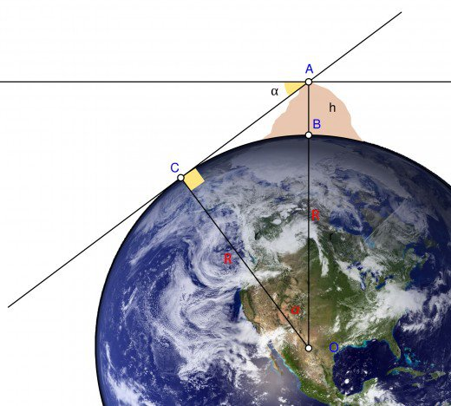
Al Biruni’s works (973 – 1048 CE)
90-a
R+h
a
Radius of Earth by Al Biruni – 6339 km (actual : 6353 – 6384 km)
Notes:
Al Biruni calculation – 6339 km (actual : 6353 – 6384 km)
(r+h) cos a = r, h cos a = r – r cos a = r (1-cos a), r = h cos a/ (1-cos a)
Angle measurement instrument - Astrolabe

