Slide 1
Science – Yesterday, Today & Tomorrow session 6
By Satish Kumar

Slide 2
Geo to Helio centric Universe
Indian Contributions
Aryabhatta – Earth’s axis, Trigonometry
Ardha jiya (half chord) > jya (short) > jiba (Arabic) > jaib (pocket) > sinus (Latin) > sine (English)
Brahma Gupta – Indo-Arabic number system
Varahamihira – Optics, Algebra
Bhaskara – Astronomy, Calculus
Lalla - Astronomy
Kerala school of Maths - Madhava, Parameshwara, Somayaji

Slide 3
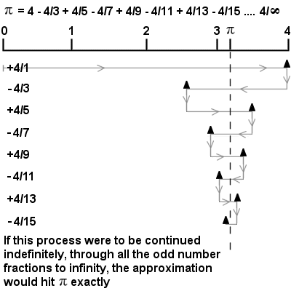
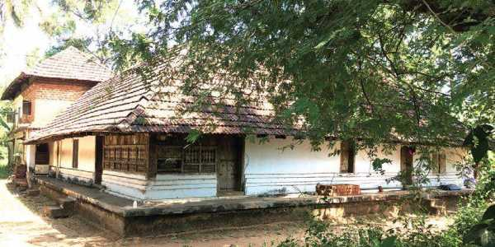
Madhava’s (1340-1425 CE) infinite series
Iringatappally Mana – Madhava’s home
https://www.youtube.com/watch?v=B8IB6D6Ew_8
Notes:
The Crest of the Peacock: Non-European roots of Mathematics’ book by George Geevarghese Joseph
Madhava-Gregory series

Slide 5
Seasons

Slide 6
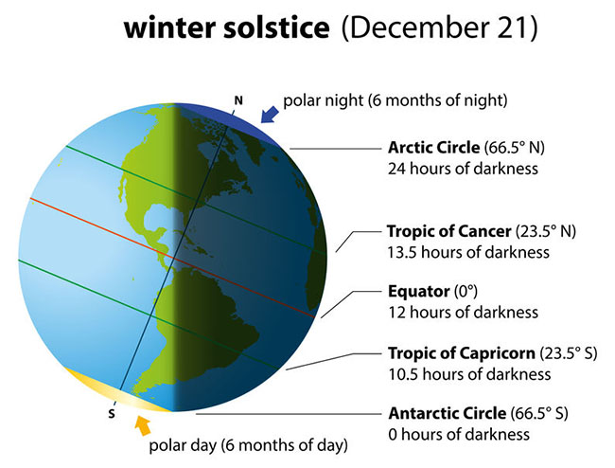
23.5˚
23.5˚

Slide 7
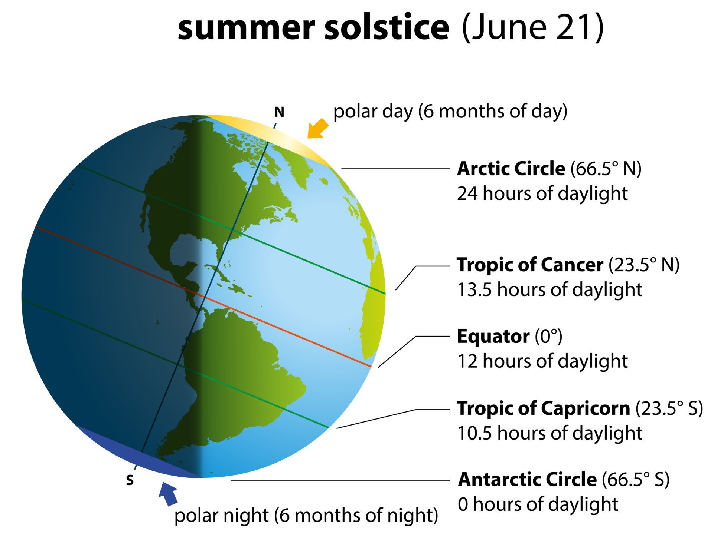
23.5˚
23.5˚

Slide 8
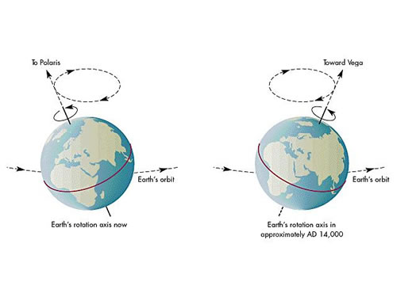
Precession
Earth rotation axis in 2020
After 12900 years
25800 years ~365 days of season shift = 365x24x60 min
1 year ~ 365x24x60/25800 = 20 min of season shift
(Sidereal year – Solar year)
Notes:
These dates will change due to precession aka conical movement of earth axis. One complete rotation of axis completes in 25800 years. This means in every 12900 years, the equinox and solistice would shift by 6 months. Shift of equinox/solistice 20 min per year which is the difference between sidereal year and tropical year (365d*24h*60m/25800y = 20 min per year)
Sidereal year takes star as reference and is 20 min longer than solar or tropical year

Slide 9
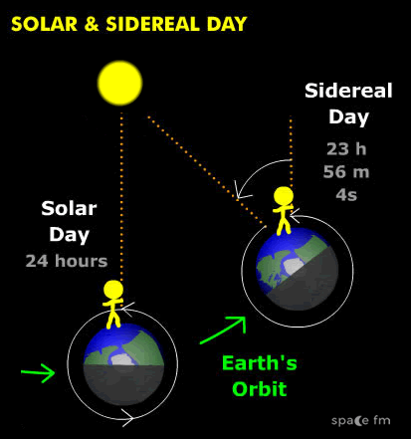
Sidereal day
360 deg ~ 24 hrs
~ 24x60 min
360/365 ~ 1˚
1 deg ~ 24x60/360 = 4 min

Slide 10
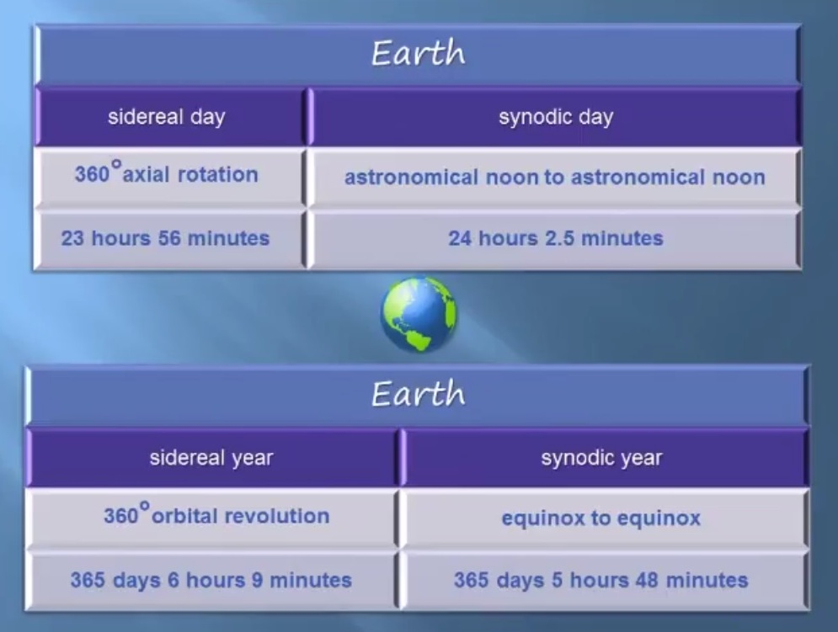
Sidereal time
Sidereal day
Solar day
Sidereal year
Solar year

