Slide 1
Science – Yesterday, Today & Tomorrow session 5
By Satish Kumar

Slide 2
Greek Science - Scientists
Euclid (~300 BCE)
Elements, Geometry: Axioms & Theorems
Pliny (23-79 CE) – Botany & Zoology
Hippocrates (460 – 370 BCE) – Father of modern medicine
Segregation of religion and medicine
Galen (129 – 210 CE)
Anatomy by dissection of monkeys, Functions of brain, heart
Archimedes (288 – 212 BCE)
Buoyancy, Defense equipment, Screw/Claw, Geometric series
Notes:
Hippocrates oath
Pythagoras – 10 (1+2+3+4) heavenly bodies, Number as rational basis of order in Universe
Elements – Euclidean geometry
Things that are equal to the same thing are also equal to one another (formally the Euclidean property of equality, but may be considered a consequence of the transitivity property of equality).
If equals are added to equals, then the wholes are equal (Addition property of equality).
If equals are subtracted from equals, then the remainders are equal (Subtraction property of equality).
Things that coincide with one another are equal to one another (Reflexive Property).
The whole is greater than the part

Slide 3
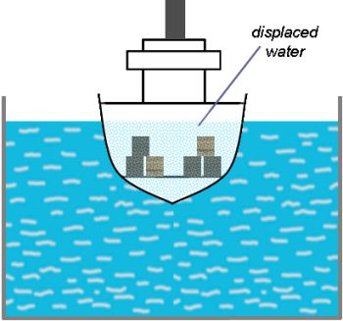
F = Weight of displaced water
F = Weight of ship

Slide 4
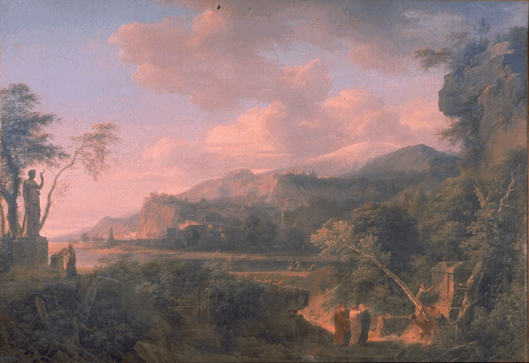
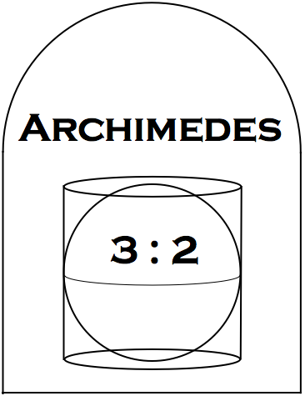
Cicero’s discovery of Archimedes’ tomb
by the French painter Pierre Henri de Valenciennes (1750-1819)

Slide 6
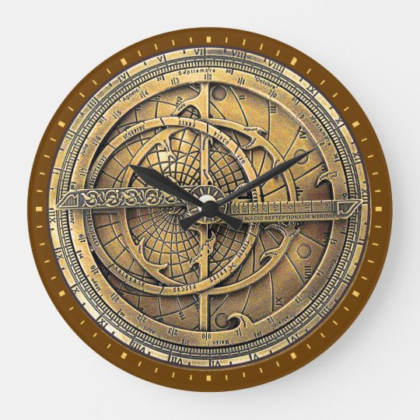
Astrolabe

Slide 7
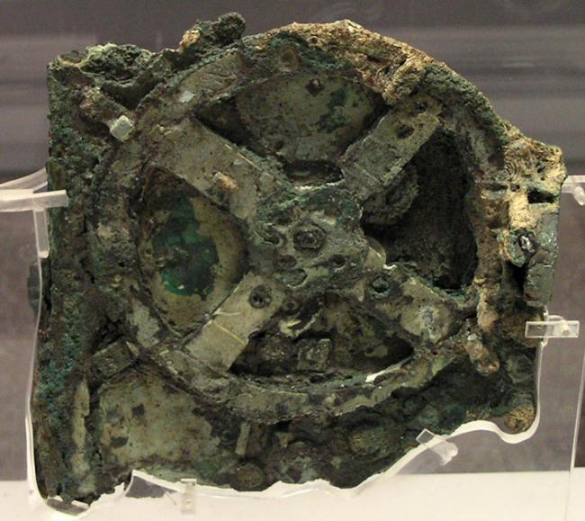
Antikythera mechanism
Notes:
Found housed in a 340 millimetres (13 in) × 180 millimetres (7.1 in) × 90 millimetres (3.5 in) wooden box, the device is a complex clockwork mechanism composed of at least 30 meshing bronze gears. to predict astronomical positions and eclipses for calendrical and astrological purposes

Slide 8
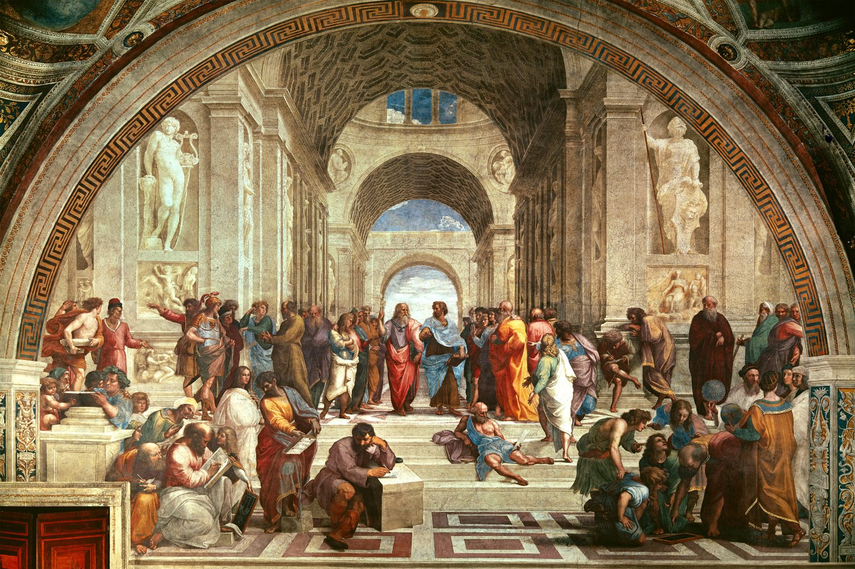
School of Athens
Notes:
Raphael – Italian Renaissance artist. Part of trinity of great masters along with Michael Angelo and Leonardo Da vinci

Slide 9
School of Athens

Slide 10
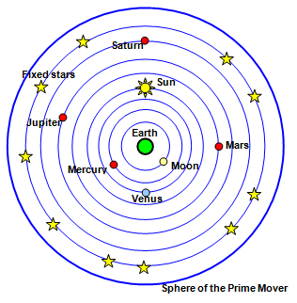
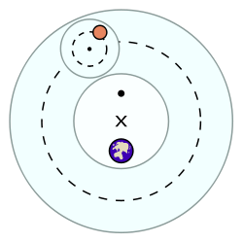
Ptolemaic Universe (2nd century AD)
https://www.youtube.com/watch?v=EpSy0Lkm3zM
Notes:
small circle – epicycle for managing Retrograde, large circle – deferent for managing difference in duration of seasons, Equant – for accounting variations in planet orbits. Reasons for proposing geocentric model – Earth looked stationary and Sun was appearing to rotate earth. Stars looked stationary (No Parallax). Constant size of Venus at whole times.

Slide 11
Geocentric Universe
Stable Sun, Moving Earth
Aristotelian theory of Force
Parallax
Sizes of Mercury & Venus
Faith
Notes:
In Geo centric model, only one phase of Venus can be observed. Galileo proved with his advanced Telescope that all phases of Venus can be viewed

