Slide 1
Science – Yesterday, Today & Tomorrow, session 3
By Satish Kumar

Slide 2
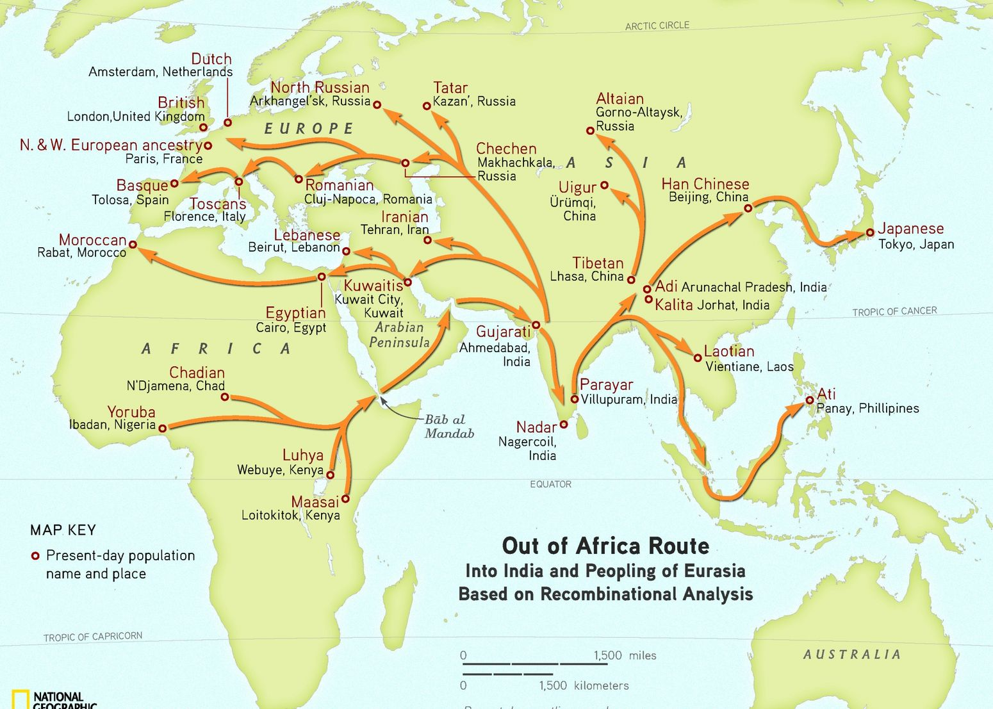
Genographic project report, 2011 by IBM and Nat Geo

Slide 4
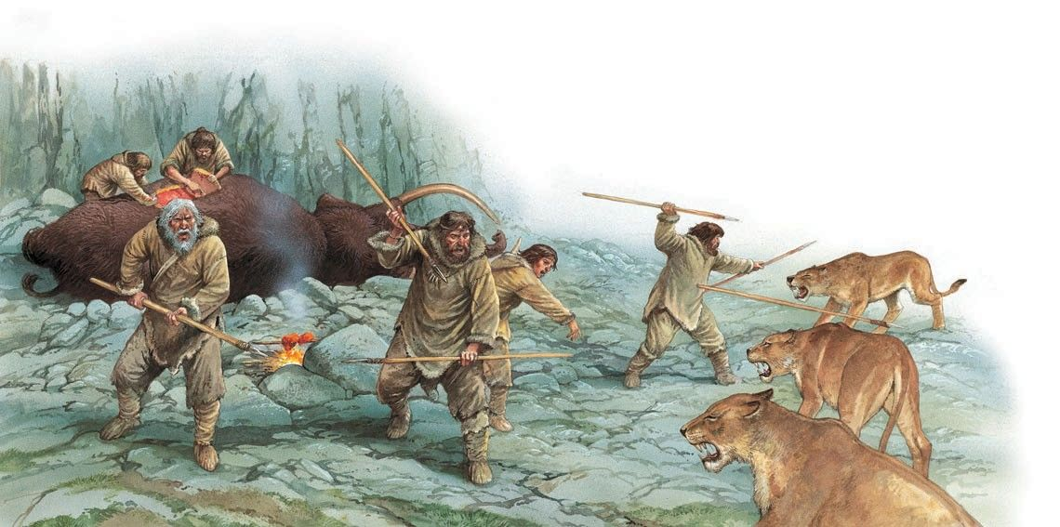
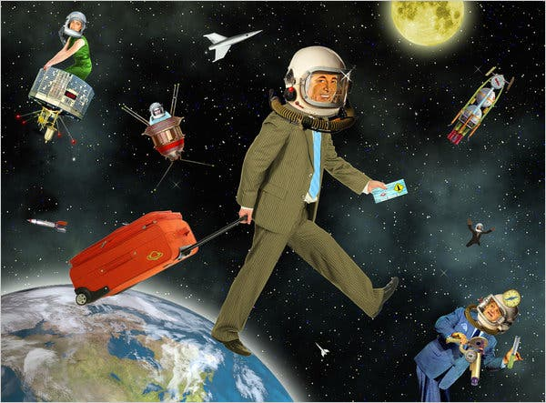

Slide 5
Human evolution timeline…
Notes:
Assignment - Gobekli Tepe

Slide 6
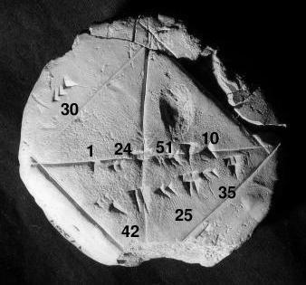
Ancient Science
Mesopotamia - 3500 BC onwards
Wheel
Calendar
60 base system
Basic Algebra
Functional Astronomy
Notes:
Wheel – Exercise : Pi, Calendar – Role play: Moon phases, Moon’s rotation
60 base system – 60 minutes, 60 seconds, 360 degree

Slide 7
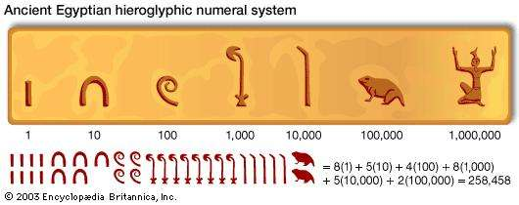
Ancient Science
Egyptian - 3rd Millennium onwards
Nile floods
Geometry – Geo (Earth) + Metry (Measuring),
Pyramids
Metallurgy
Glass making
365 day calendar
Fractions
Notes:
Wheel – Exercise : Pi, Calendar – Role play: Moon phases, Moon’s rotation
60 base system – 60 minutes, 60 seconds, 360 degree

