Slide 1
Science – Yesterday, Today & Tomorrow session 12
By Satish Kumar

Slide 2
Gravitational force
Gravitational force between Earth and an object of mass, m on Earth’s surface =
G - Gravitational constant
M – Mass of Earth
R – Radius of Earth
= GMm/R²
F = ma
a = F/m
Gravitational acceleration =
GM/R²
g ~ 9.8 m/s²

Slide 3
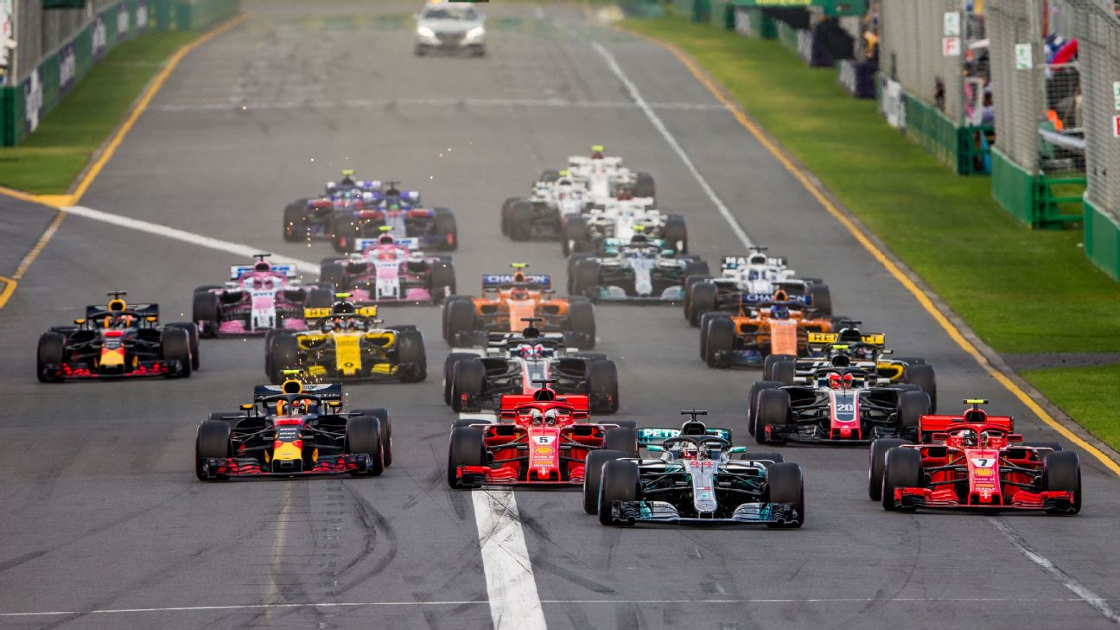
Who will win?

Slide 4
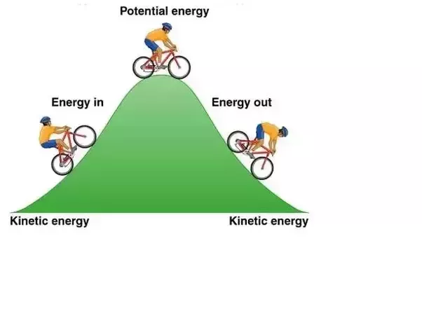
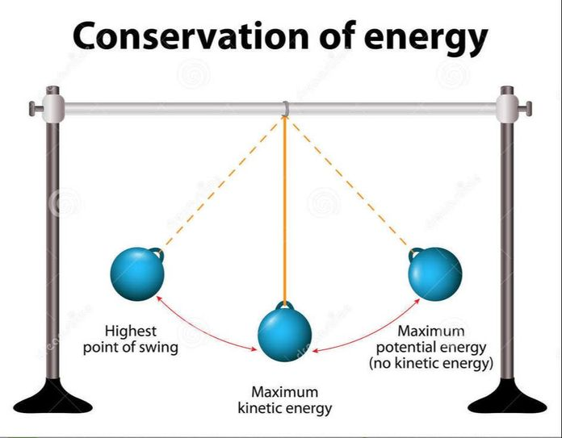
Work = mgh
= Potential energy
Work done = Force x Displacement
h
mg

Slide 5
