Slide 1
Science – Yesterday, Today & Tomorrow session 11
By Satish Kumar

Slide 2
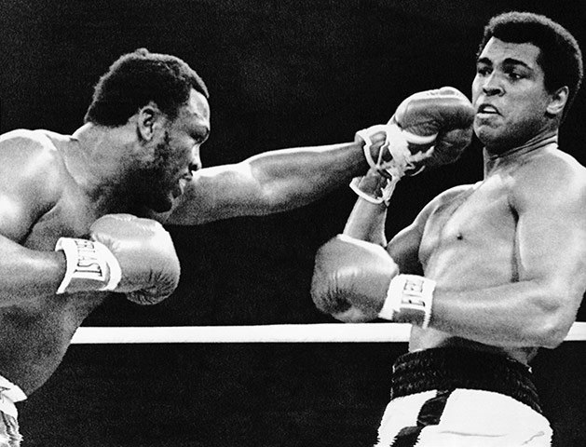
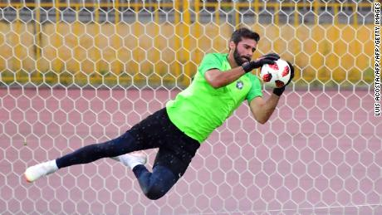
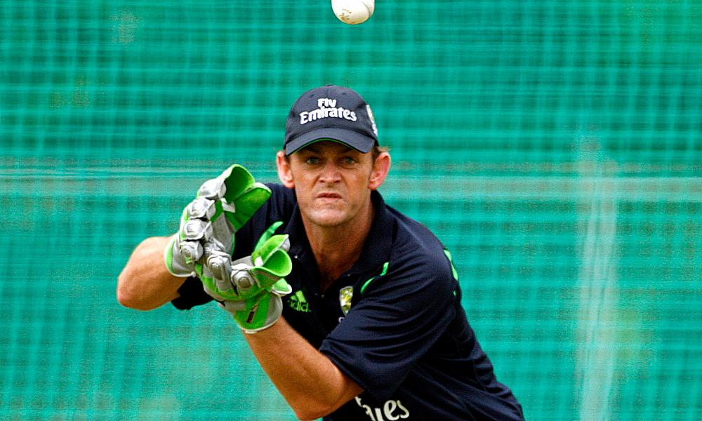
Notes:
Role play for momentum - catch

Slide 3
Case 1 – Catching the cricket ball with firm hands
Mass – 1 kg
Speed – 10 m/s
Ball stops in 0.5 s
Momentum = Mass x Velocity
Initial momentum =
1 kg x 10 m/s = 10 kg m/s
Final momentum =
1 kg x 0 m/s = 0
Force = Rate of change of momentum
= (Final momentum – Initial momentum) / Time
= (10-0) / 0.5 kg m/s /s
= 20 kg m/s²
= 20 N

Slide 4
Case 2 – Catching the cricket ball by pulling back hands
Mass – 1 kg
Speed – 10 m/s
Ball stops in 2 s
Initial momentum =
1 kg x 10 m/s = 10 kg m/s
Final momentum =
1 kg x 0 m/s = 0
Force = Rate of change of momentum
= (10-0) / 2
= 5 kg m/s²
= 5 N

Slide 5
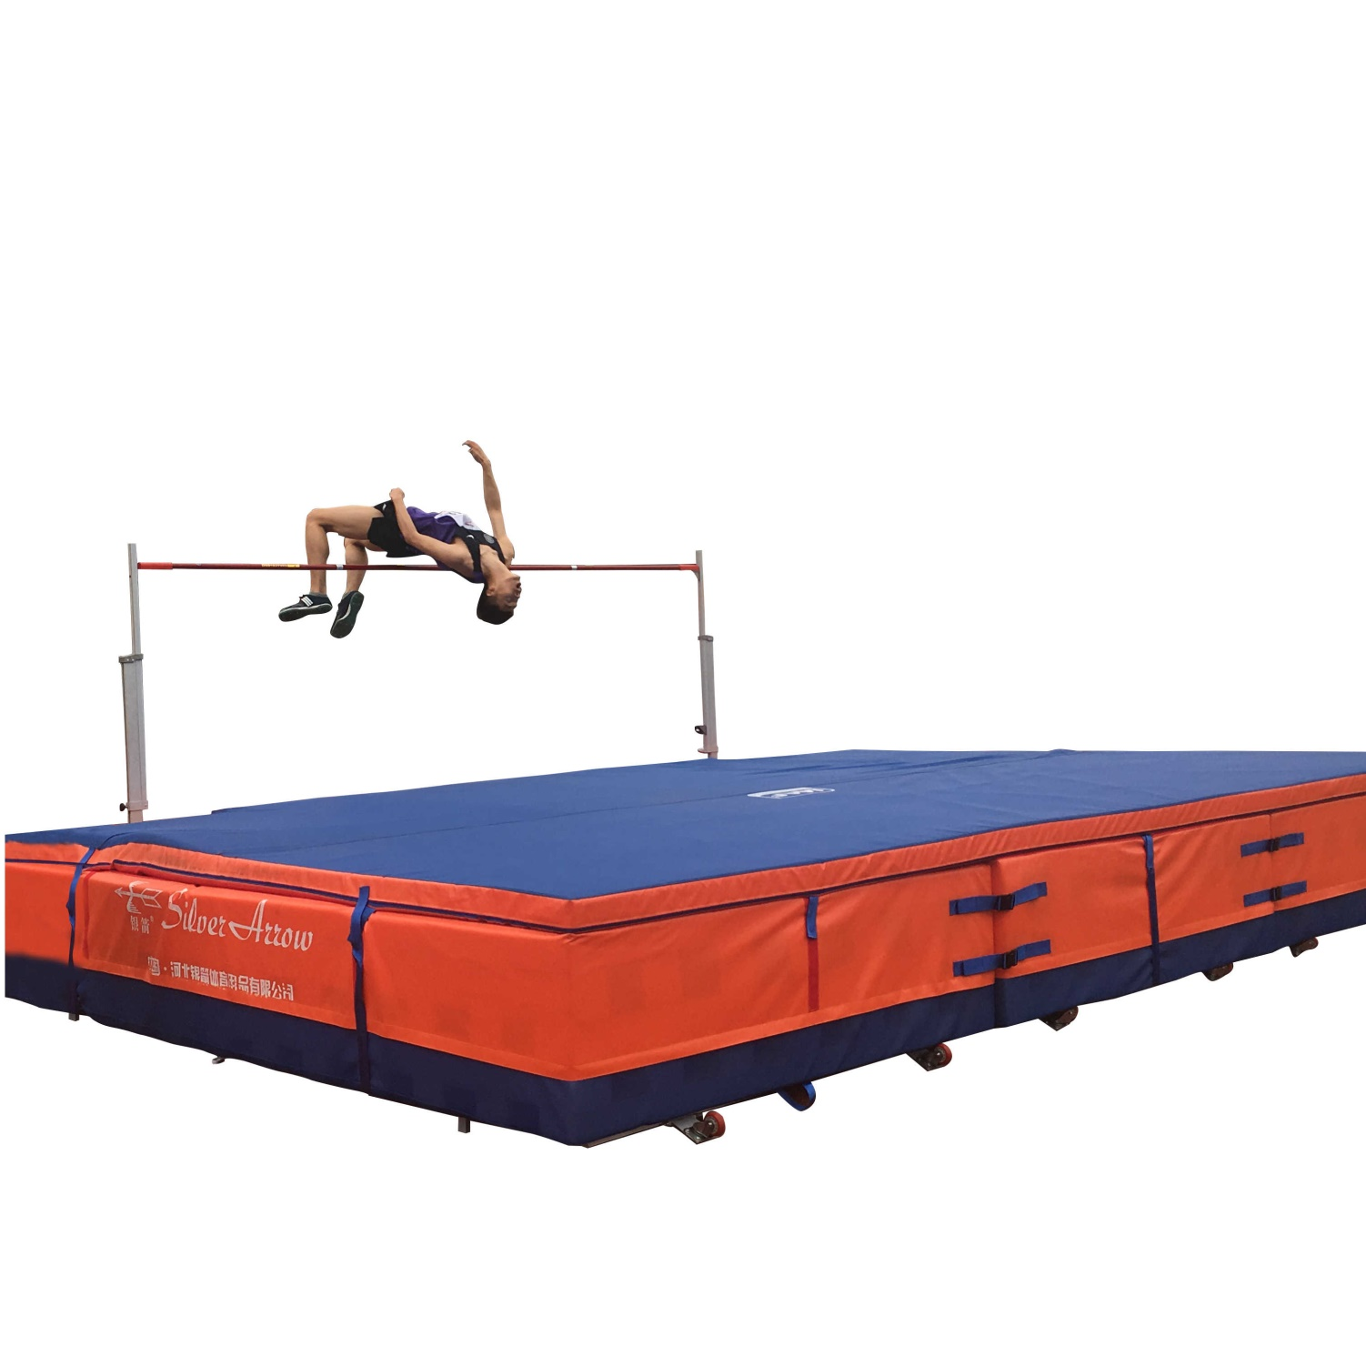

Slide 6
Isaac Newton (1643 - 1727 CE)
Mass – m kg
Speed – U m/s
Ball speed changes to V m/s in t sec
Force - F
Initial momentum =
mU kg m/s
Final momentum =
mV kg m/s
Force = Rate of change of momentum
= (mV-mU) /t
= m(V-U)/t
= ma
F = ma kg m/s² or N

Slide 7
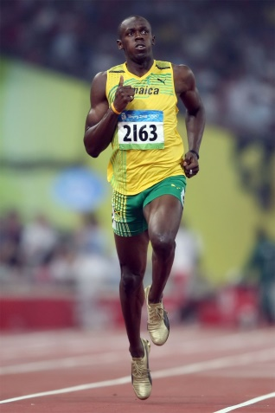
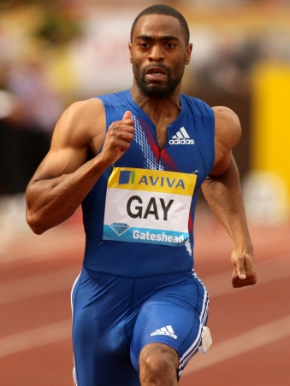
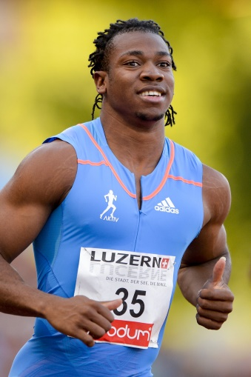
Usain Bolt
Max speed 44 km/h
attains in 20 sec
Tyson Gay
Max speed 43 km/h
attains in 15 sec
Yohan Blake
Max speed 42 km/h
attains in 8 sec
100 mtr

Slide 8
Gravitational force
Gravitational force between Earth and an object of mass, m on Earth’s surface =
G - Gravitational constant
M – Mass of Earth
R – Radius of Earth
= GMm/R²
F = ma
a = F/m
Gravitational acceleration =
GM/R²
g ~ 9.8 m/s²

Slide 9
