Slide 1
Science – Yesterday, Today & Tomorrow session 10
By Satish Kumar

Slide 2
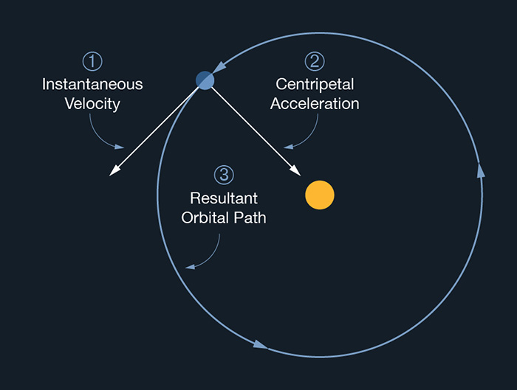
Earth’s orbit

Slide 3
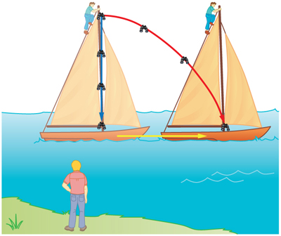
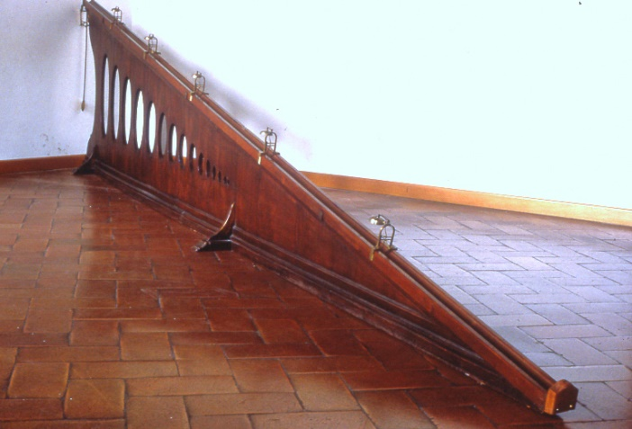
Galileo (1564 – 1642 CE)
Inertia
Force
Bodies falling on earth
Relative motion
Notes:
Two new Sciences

Slide 4
Relative motion
A train travels at 50 km/hr. A man walks inside the train in the direction of train movement at speed of 5 km/hr. What would be his speed for
1. A person standing on the field
2. A person sitting in a train, running in parallel track in same direction at 50 km/hr
3. A person sitting in a train, running in parallel track in same direction at 60 km/hr
4. A person sitting in a train, travelling in opposite direction at 60 km/hr
Frame of reference
Notes:
55
-5
115

Slide 5
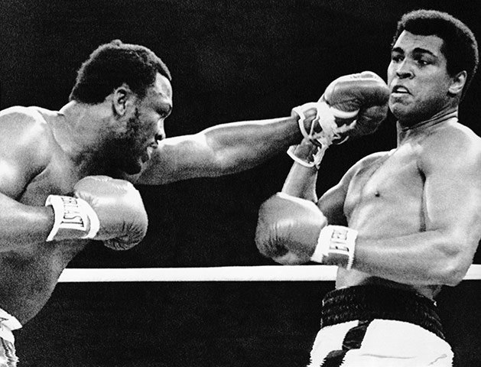
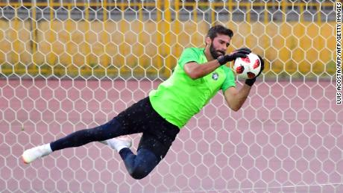
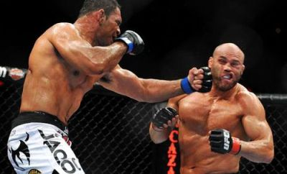
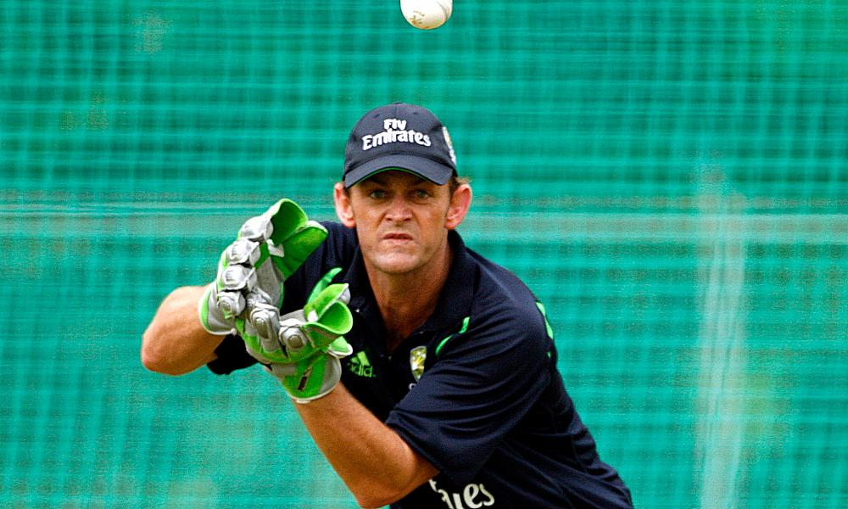
Notes:
Role play for momentum - catch

