Slide 1
Science – Yesterday, Today & Tomorrow final session
By Satish Kumar

Slide 2
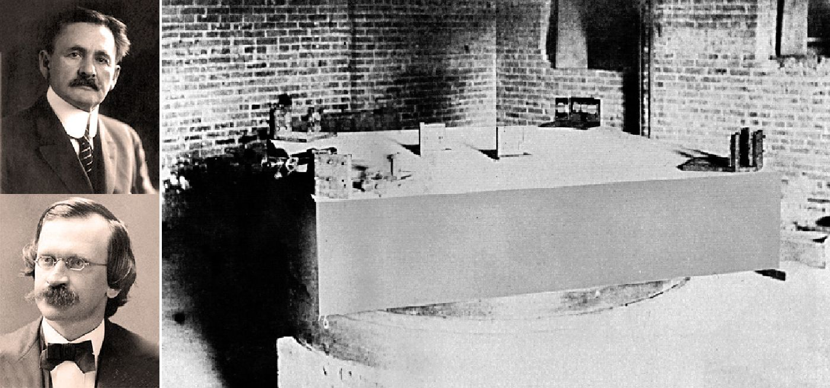
Michelson – Morley experiment (1887)
Notes:
Relativistic shooting – Bike, car - travelling in same & different directions

Slide 3
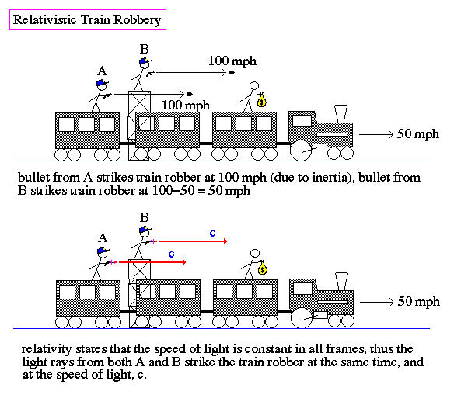

Slide 4
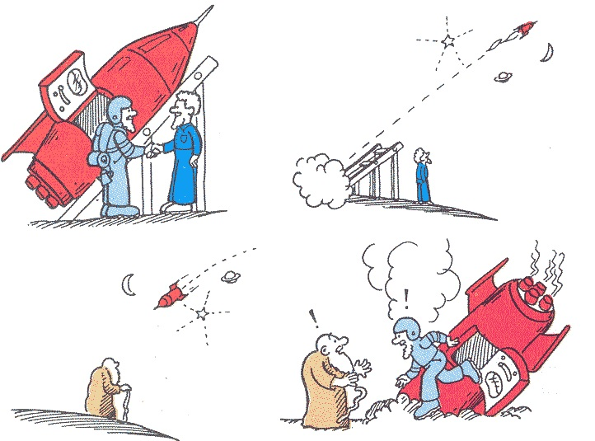
Einstein (1879 – 1955)
Michelson-Morley experiment
Speed of light
Mass-Energy equivalence (e=mc²)
Idea of space time
Twin paradox
Special relativity
Notes:
Two new Sciences

Slide 5
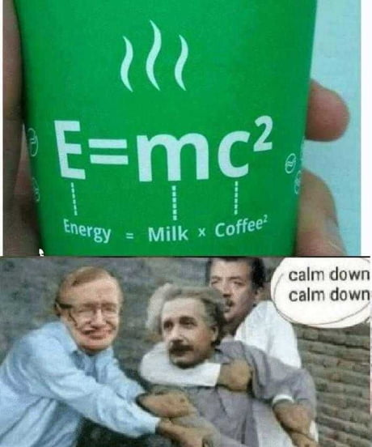
Notes:
Stephen Hawkins, Neil deGrasse Tyson

Slide 6
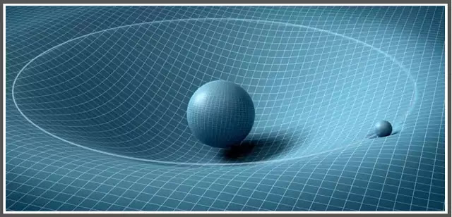
General relativity
Notes:
Team work – Sun stops burning. What happens next

Slide 7
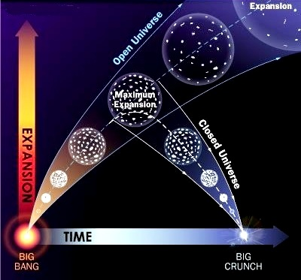
Expanding Universe
Friedmann theory
Hubble-Lemaitre law
Red shift

Slide 8
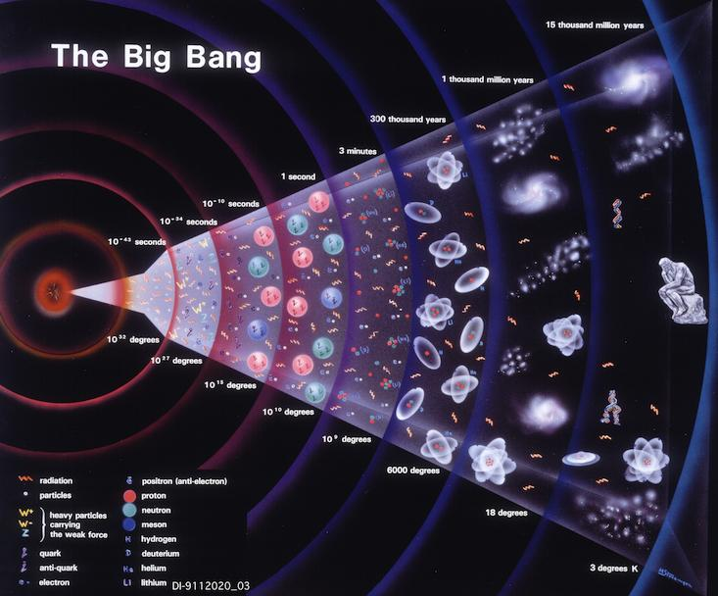

Slide 9
Change in frequency between observer and source
Traffic application, siren
Doppler effect

Slide 10
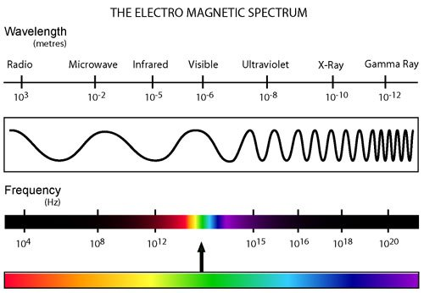
Electromagnetic spectrum

Slide 12
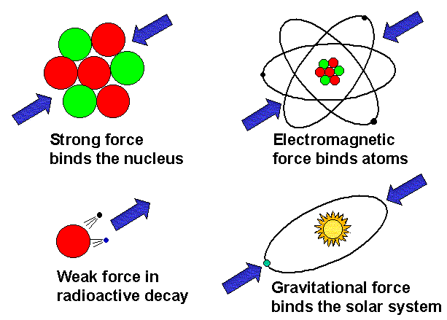
Fundamental forces

Slide 13
Particle Physics
Fundamental forces
Gravitational
Electromagnetic – Photon
Strong nuclear – Gluon
Weak nuclear - Bosons

Slide 14
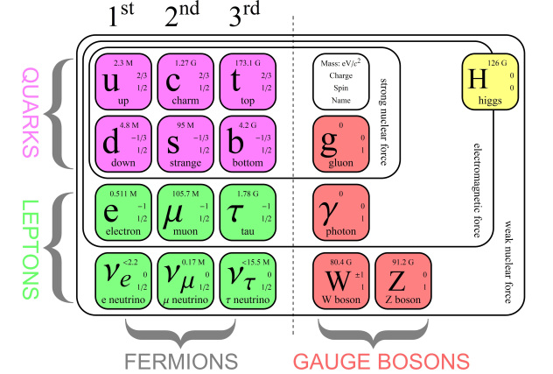
Sub-atomic structure
Notes:
Exercise - What forces created Universe?

Slide 15
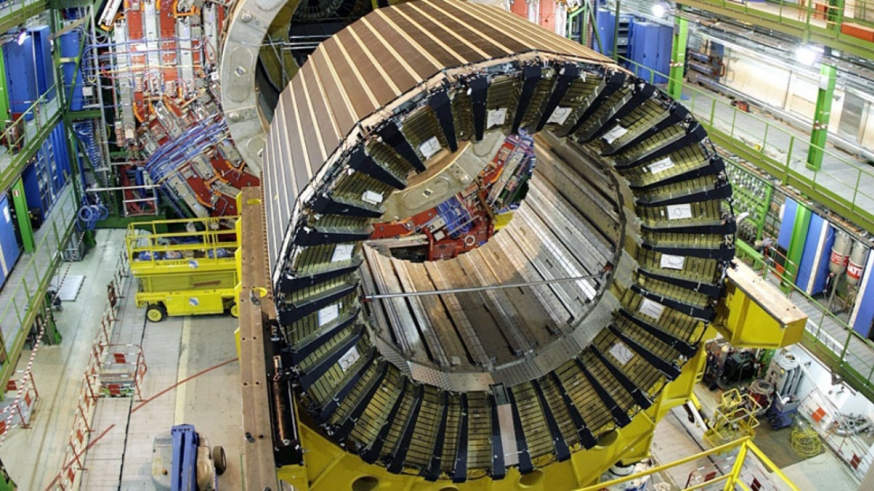
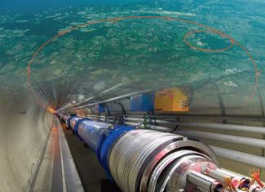
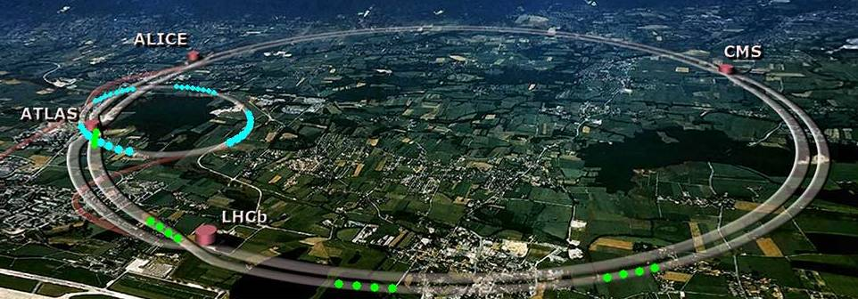
CERN LHC
Notes:
tunnel 27 kilometers (17 mi) in circumference, as deep as 175 meters (574 ft) beneath the France–Switzerland border near Geneva, Switzerland

Slide 16
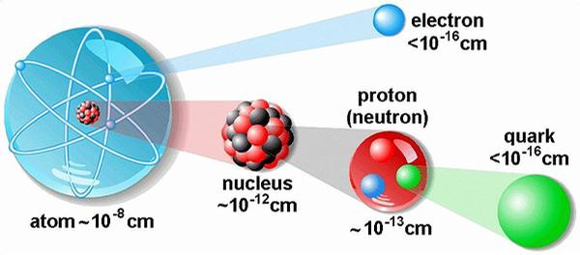
Particle physics
Fundamental building blocks
Fermions (@ Fermi) & Bosons (@ Satyendra Bose)
Particles, Anti particles, Spin, Charge, Mass

Slide 18
Quantum Mechanics
Wave – Particle duality
Quanta
Energy – Frequency relationship
Planck’s constant
Probability

Slide 19
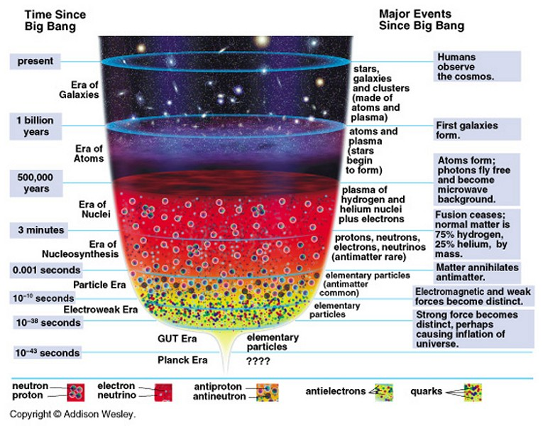
Bing Bang

Slide 21
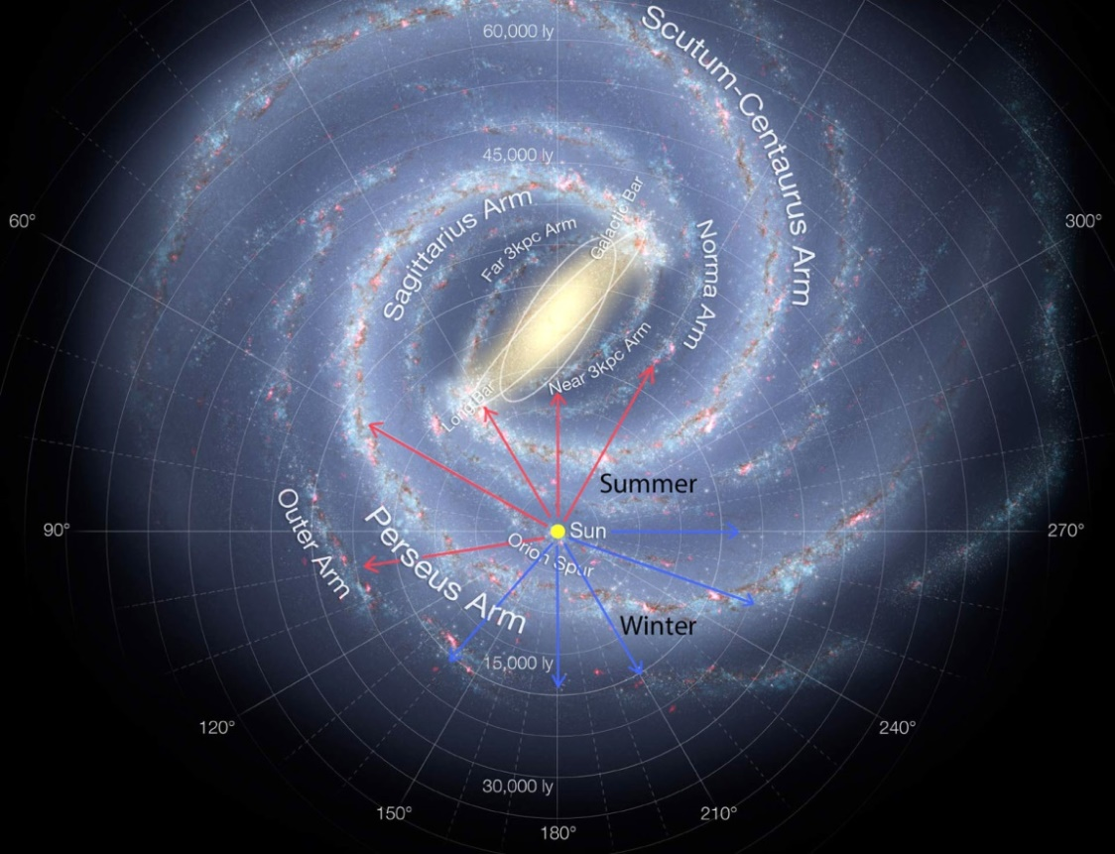
Milky way
1-1.8 lakh light years to travel across
Spiral galaxy
100-400 billion stars
Min 100 billion planets
Rotational period –
~240 million years
Velocity – 600 km/sec
Mass – 5.8×10¹¹ solar mass

Slide 22
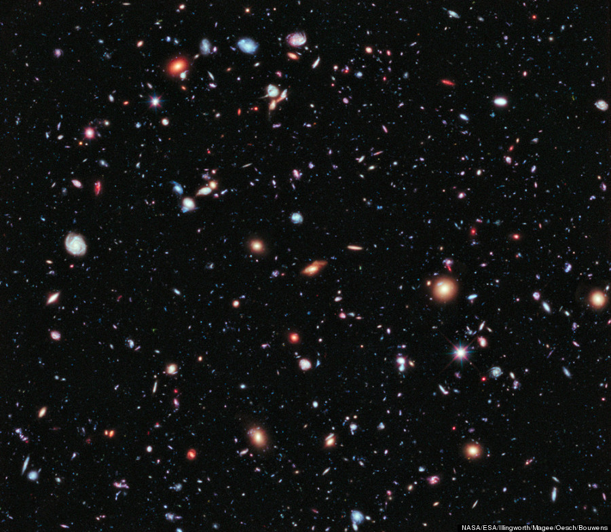
Universe as we know
Age – 13.8 billion years
Diameter - ~93+ billion light years
~2 trillion galaxies

Slide 23
Future Science
Quantum theory of gravity or Theory of everything
String theory, Loop quantum gravity
Grand Unified Theory (GUT)
Universe models (origin & collapse)
Dark energy, dark matter, Great attractor
Black holes
Particle physics
Notes:
String theory

