Slide 1
Science – Yesterday, Today & Tomorrow, session 2
By Satish Kumar

Slide 2
Why History of Science?
Rational thinking is pillar of Scientific development
Notes:
Role play – Sun and moon eclipses

Slide 3
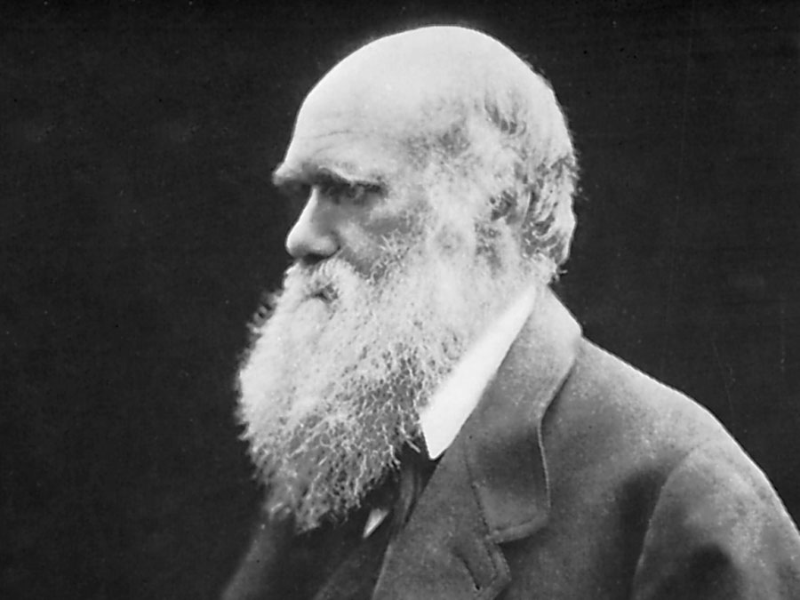
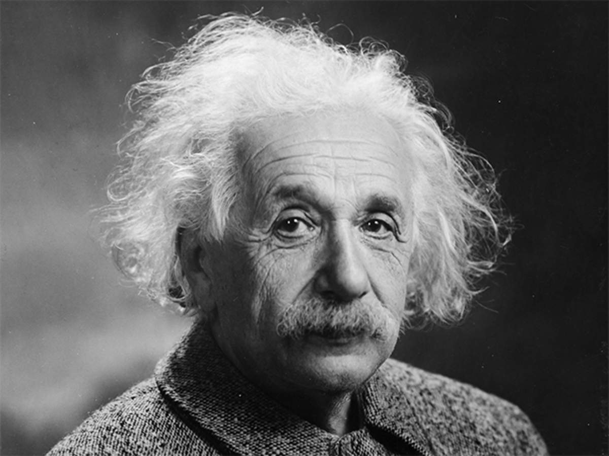
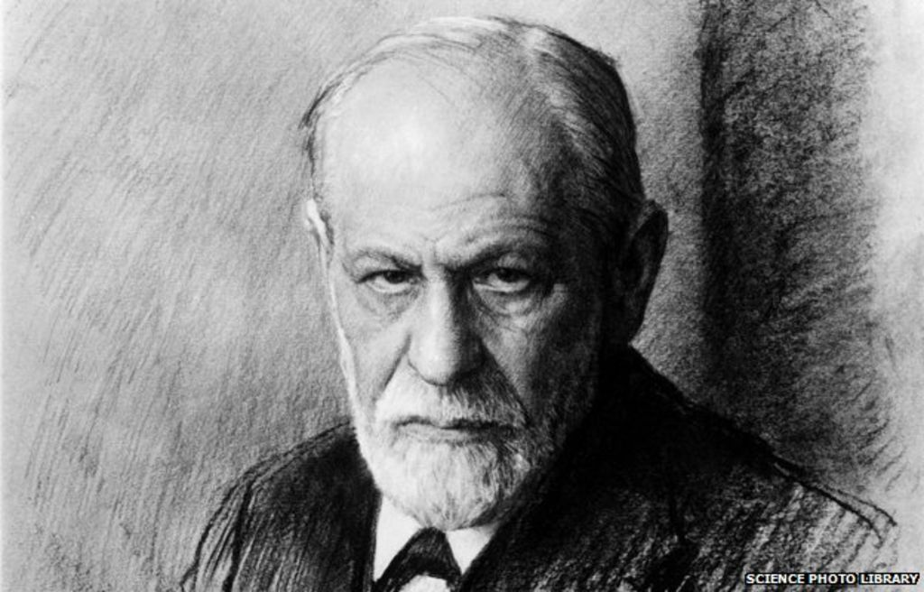
Why History of Science?
Charles Darwin
Aristotle
Pangenesis
Geo centric Universe
Albert Einstein
Sigmund Freud
Cosmological constant
Theory of sexuality
Notes:
Role play – Sun and moon eclipses

Slide 4
Why History of Science?
You can learn only through failures
Notes:
Role play – Sun and moon eclipses

Slide 5
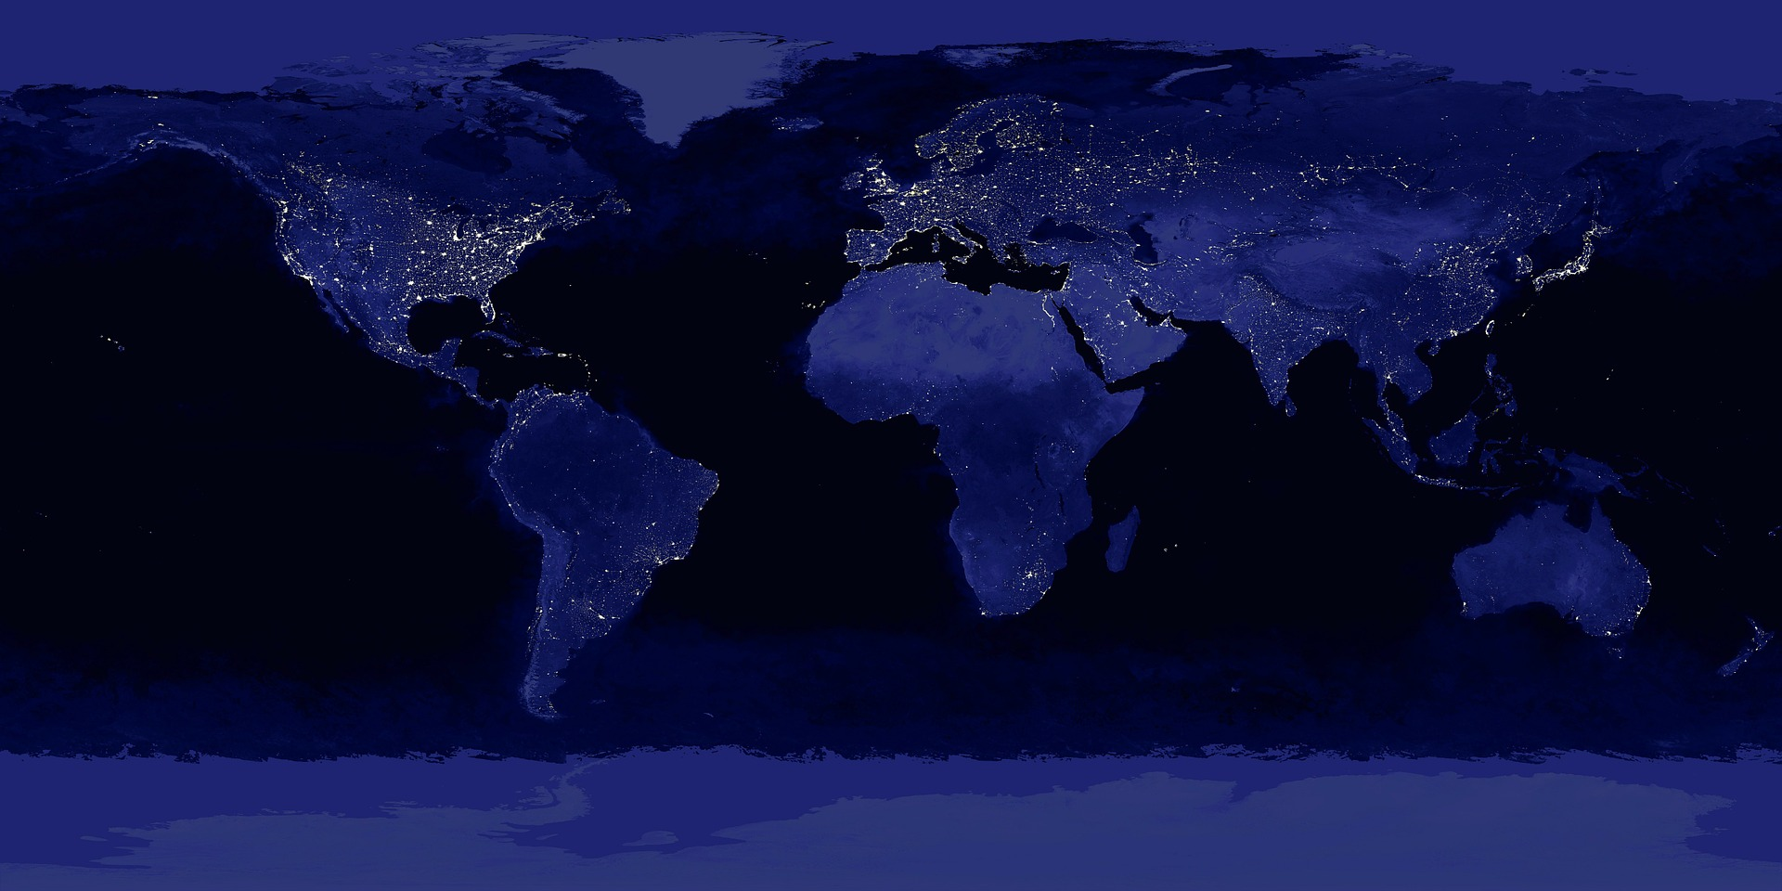
Which countries have contributed more to Science?

Slide 6
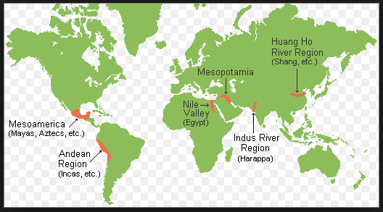

Slide 7
Why History of Science?
Civilisations have developed through collective work
Notes:
Role play – Sun and moon eclipses

Slide 8
Learning methodology

Slide 9
How to learn?
Be prepared for the class
Listen the lecture. Note important points only
Be engaged in the class room
Answer questions without fear; there can be many right answers.
Ask doubts; all doubts are good doubts
Attempt all problems; you can’t learn without failing
Actively participate in team works
Recap and note points learned during the day
Collect and read related articles, news and books
Engage in projects, conduct experiments
Teach others

Slide 10
13.8 B
years
Age of Universe
4.5 B
years
Age of Earth
4+ B
years
Age of first living organism
8.7+ M
No. of species on Earth

Slide 11
Human evolution timeline….
Notes:
Assignment – Dragon man

Slide 12
Cradle of human kind, South Africa

