Slide 1
Science – Yesterday, Today & Tomorrow
By Satish Kumar

Slide 2
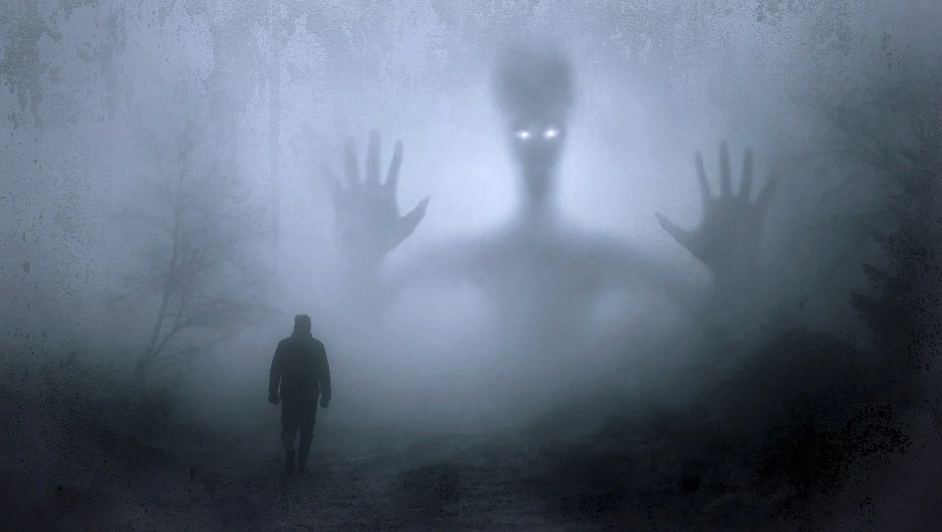
Have you seen ghosts?

Slide 4
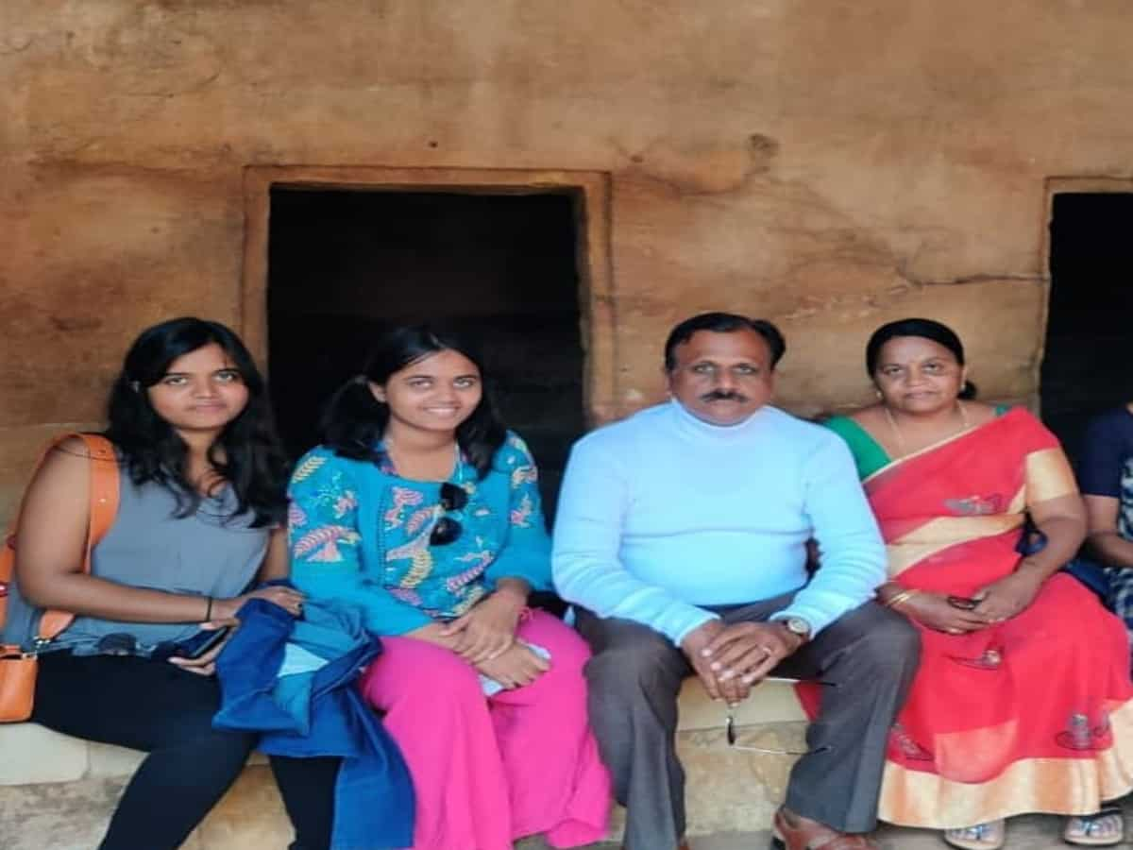

Slide 5
What is not Science?

Slide 6
Scientific thought process
What happens?
How it happens?
Why it happens?
What will happen tomorrow?
What would have happened yesterday?

